Slide 1
Deconstructing Actual Neurons

Slide 2
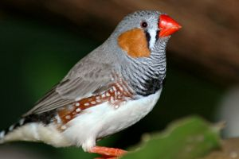
The Male Zebra Finch
spectogram
Motif (~1 sec duration)

Slide 3
The Male Zebra Finch
spectogram
Motif (~1 sec duration)

Slide 4
The Song Control System

Slide 5
In vivo spiking patters of HVC_{RA} and HVC_{int}
HVC_{RA}
activity
Hahnloser .. Fee, Nature, 2002

Slide 6
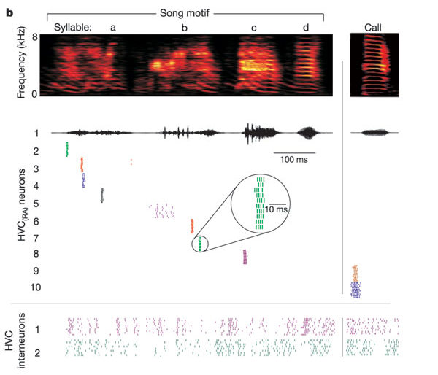
In vivo spiking patters of HVC_{RA} and HVC_{int}
HVC_{RA}
activity
Hahnloser .. Fee, Nature, 2002

Slide 7
In vitro Electrophysiology of HVC neurons
Blue=depolarizing current injection
Black=hyperpolarizing current injection

Slide 8
Electrophysiology of HVC neurons
Blue=depolarizing current injection
Black=hyperpolarizing current injection

Slide 9
Electrophysiology of HVC neurons
Blue=depolarizing current injection
Black=hyperpolarizing current injection

Slide 10
Replicate With A Single-Neuron Model

Slide 11
The Ion Channel Expression

Slide 12
Infinity Functions for the Channels

