Slide 1
A Hybrid Approach to Understanding Cell Dynamics
Richard Bertram
Department of Mathematics and
Programs in Neuroscience and Molecular Biophysics
Florida State University, Tallahassee, FL.
Funding: NIH DK043200
NSF DMS1220063
WVU Mathematics, 2013

Slide 2



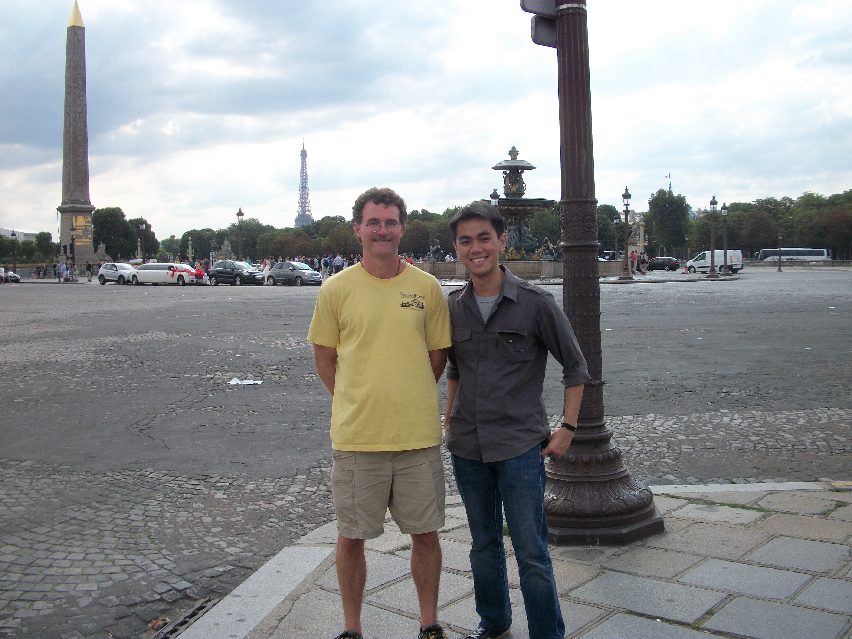
Joël Tabak
Wondimu Teka
Patrick Fletcher
Maurizio Tomaiuolo
Martin
Wechselberger
Theo Vo

Slide 3
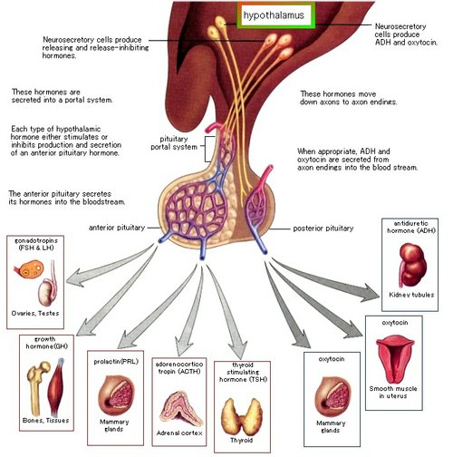
Hypothalamus and Pituitary

Slide 4
Five types of anterior pituitary cells
Lactotrophs: secrete prolactin
Somatotrophs: secrete growth hormone
Gonadotrophs: secrete luteinizing hormone and
follicle stimulating hormone
Corticotrophs: secrete ACTH
Thyrotrophs: secrete thyroid stimulating hormone

Slide 5
Thanks to Arturo Gonzalez-Iglesias, Jose Arias-Cristanch, and Ruth Cristancho-Gordo
Immunocytochemistry for prolactin, growth hormone,
and leutinizing hormone.

Slide 6
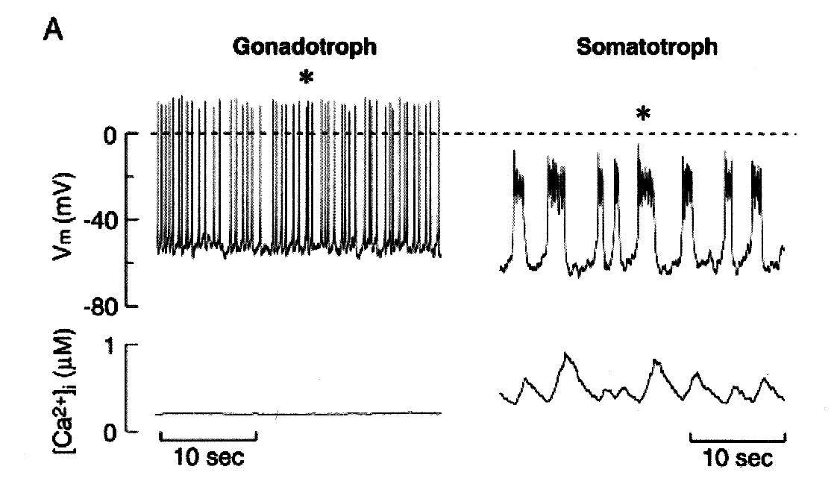
Goal
Use mathematical modeling and analysis to help
understand the electrical activity of the different
types of endocrine pituitary cells
Spiking, little
secretion
Bursting,
much more
secretion
Van Goor et al., J. Neurosci., 2001:5902, 2001

Slide 7
Ca²⁺
Ca²⁺
pump
K+ (BK)
fast
[Ca²⁺]
Ca²⁺
Ca²⁺
Ca²⁺
K+
Ca²⁺
Ca²⁺
Ca²⁺
Ca²⁺
KDR,SK
slow
Ca²⁺
Ca²⁺
leak
K⁺
K⁺
K⁺
K⁺
K⁺
K⁺
K⁺
K⁺
K⁺
K⁺

Slide 8
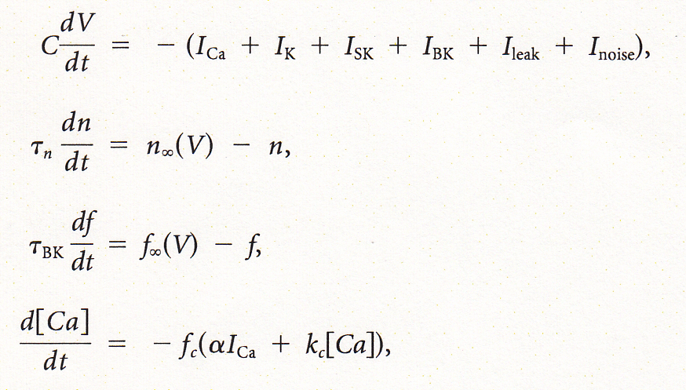
Equations
voltage
I_{K} activation
I_{BK} activation
cytosolic calcium
Ionic current have an Ohmic form, e.g.,
Conductance and time constants are all parameters.
There are more parameters in the equilibrium functions.

Slide 9
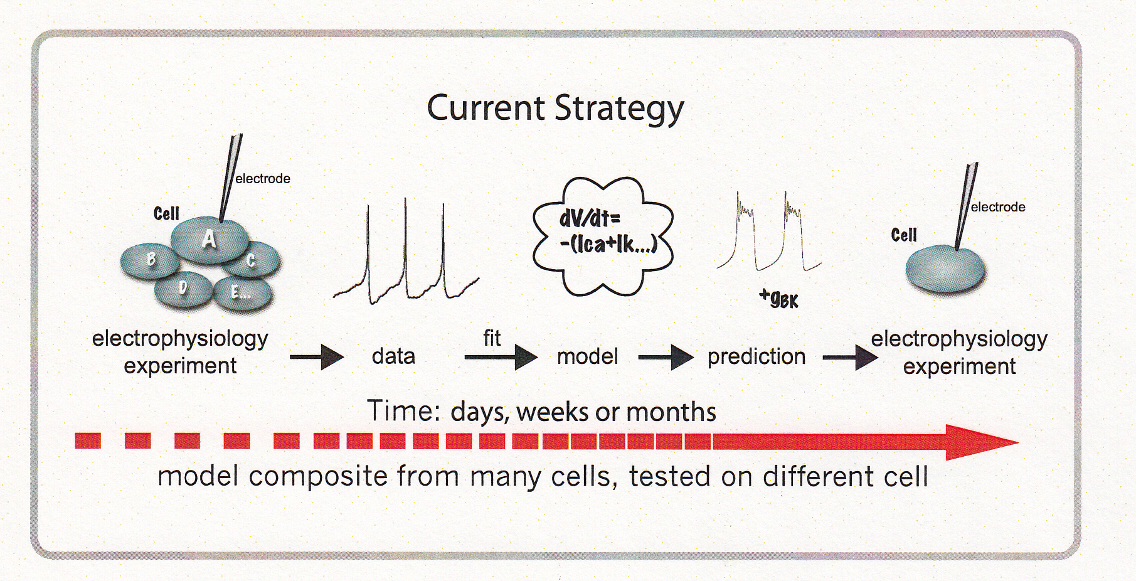
Picking parameter values
If your model has 10 or more parameters, how
do you find values for them all?

Slide 10
Heterogeneity…a big problem
The mix of ionic currents within a single cell type is
highly variable, as shown with the GH4C1 cell line…
Cell 1
Cell 2
Cell 3

Slide 11
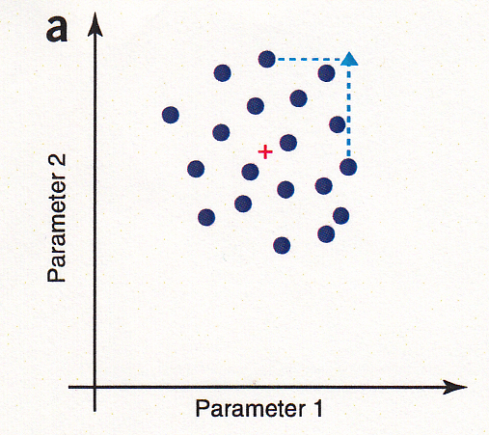
Possible parameter distribution scenarios
+ = mean of distribution
Marder and Taylor, Nature Neurosci., 14:133, 2011
Averaging over distribution should be fine

Slide 12
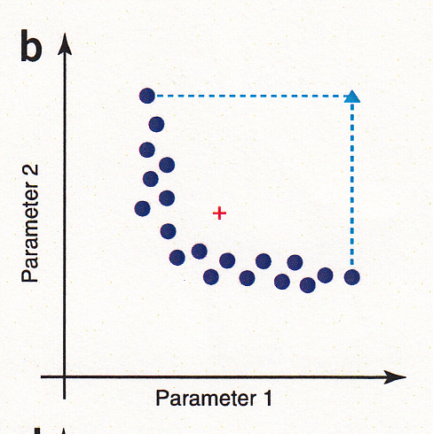
Possible parameter distribution scenarios
+ = mean of distribution
Marder and Taylor, Nature Neurosci., 14:133, 2011
Averaging puts you out of the distribution

Slide 13
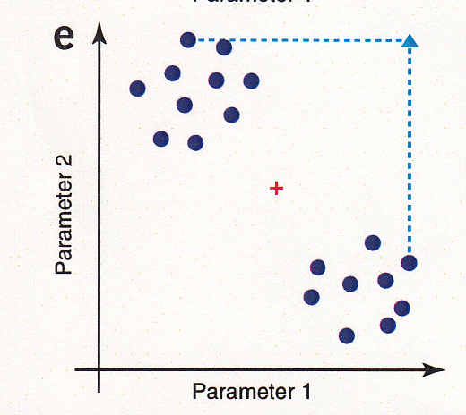
Possible parameter distribution scenarios
+ = mean of distribution
Marder and Taylor, Nature Neurosci., 14:133, 2011
Averaging puts you out of the distribution

Slide 14
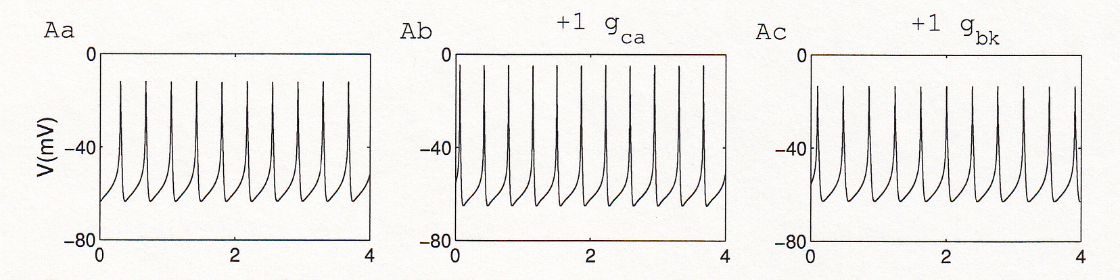
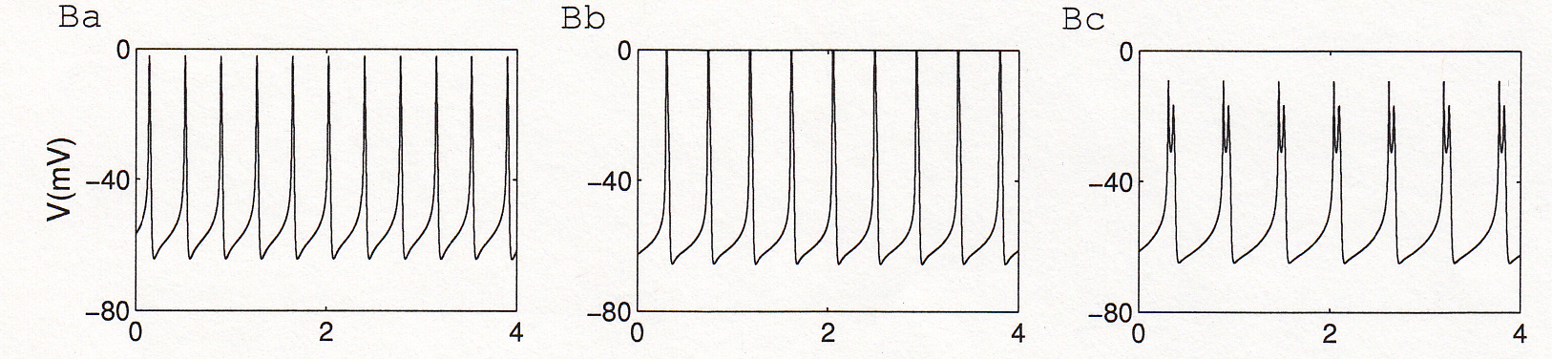
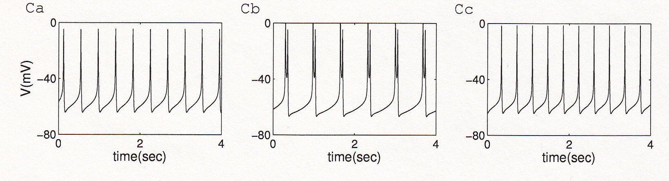
Why does this matter?
One spiking model
cell
Another spiking
model cell
A third spiking
model cell
Tomaiuolo et al., Biophys. J., 103:2021, 2012

Slide 15
Fast and Slow Dynamics
Analyze the reduced system obtained in the limit
Voltage V is in a state of quasi-equilibrium with n and c

Slide 16
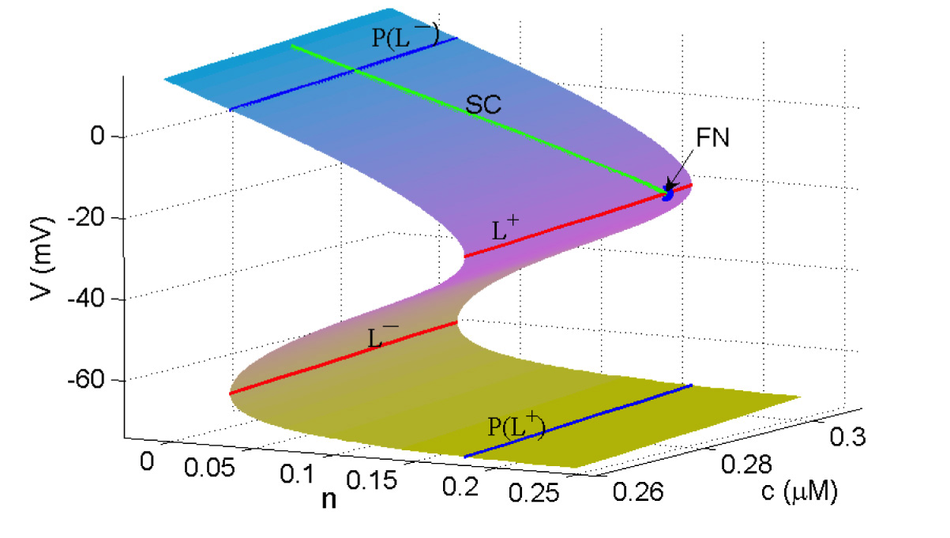
The Critical Manifold
Surface in 3-space where V is at quasi-equilibrium
RHS of V-ODE:
Critical manifold:

Slide 17
The Reduced and Desingularized Systems
RHS of V-ODE:
Critical manifold:
Dynamics on S:
Reduced system:
With n satisfying
=0 on folds
Desingularized system:
with

Slide 18
Equilibria of the Desingularized System
Equilibrium
Conditions
Regular
Singularity
Folded
Singularity
(On a fold curve of S)
Folded Node: A folded singularity with two real eigenvalues

Slide 19
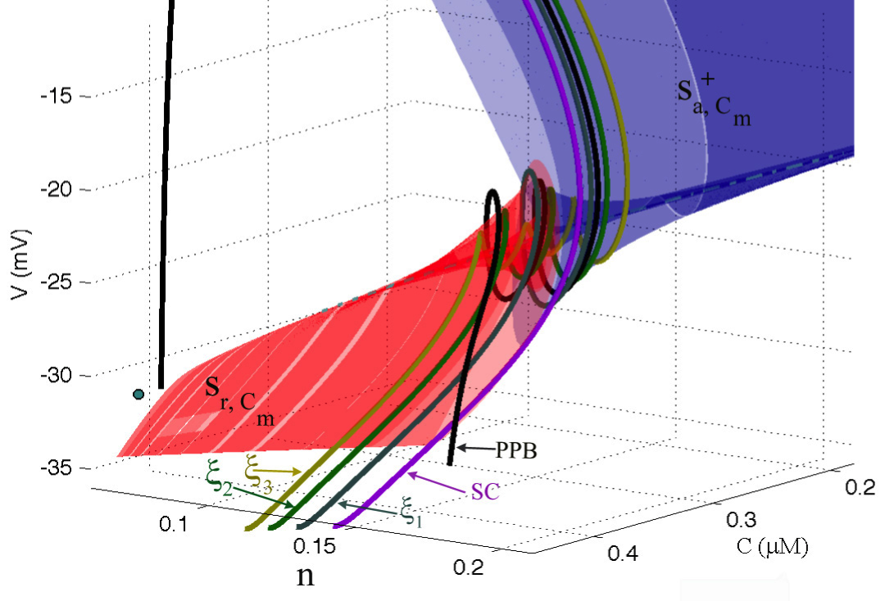
Geometric Singular Perturbation Theory tells us about the origin of bursts
The “spikes” of the bursts are small rotations of the
burst trajectory that occur due to the presence of a
folded node singularity in the singular system.
Bursting orbit
Secondary
canards

Slide 20
Prediction: Adding BK conductance increases the burstiness
Diameter: active phase duration
Color: number of spikes per active phase
Teka et al., J. Math. Neurosci., 1:12, 2011

Slide 21
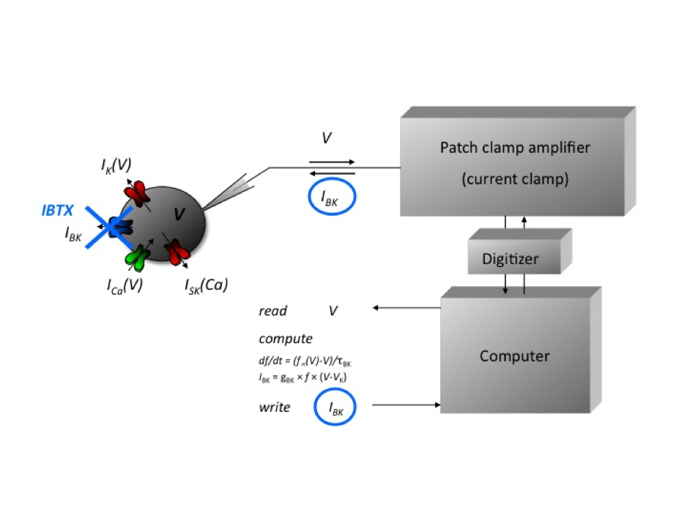
The Dynamic Clamp: a tool for adding a model current to a real cell

Slide 22
Prediction tested using D-clamp
BK pharmacologically blocked
Add back some BK current
with D-clamp
Add more BK current
Summary
Bertram et al., in press

Slide 23
Prediction: Subtracting K(dr) conductance increases the burstiness
Diameter: active phase duration
Color: number of spikes per active phase
Teka et al., J. Math. Neurosci., 1:12, 2011

Slide 24
Prediction tested using D-clamp
Control cell
Subtract some K(dr)
current
Subtract more K(dr)
current
Summary
Bertram et al., in press

Slide 25
Problem: since we don’t know true parameter values and the cells are heterogeneous our ability to make predictions is limited

Slide 26
What we’d like to do…
Parameterize the model to an individual cell,
while still patched onto that cell. Then different
cells will have different parameter vectors.

Slide 27
Set parameters to fit features of the voltage trace,
rather than the voltage trace itself
peaks
amplitude
V (mV)
silent
active
period
min
Time (sec)

Slide 28
Feature fitness function
F=fitness function
m_{j}=model feature
d_{j}=data feature
c_{j}=feature weight
σ_{j}=feature scaling

Slide 29
Also fit voltage clamp data

Slide 30
Voltage clamp fitness function
Im_{k}=current from model
Id_{k}=current from data
λ_{k}=scaling factor
and
Maximize
where

Slide 31
Optimization using a genetic algorithm
p₂
p₂
selection
p₁
p₁
replication with mutation
p₂
repeat
p₁

Slide 32

We need rapid calibration, so use
a Graphics Processing Unit (GPU)
Programmable
Graphics Processing Unit
Cost < $ 1000

Slide 33
Feature planes can be rapidly computed
100x100 grid
10,000 simulations
Simulation time=70 sec each
Total computation time=20 sec

Slide 34
Example: Calibrate the model to a spiking
cell and make/test predictions
data
model fit

Slide 35
Prediction 1: Adding BK current converts
spiking to bursting

Slide 36
Prediction 2: The transition to bursting
requires fast activation of the BK channels
ctrl
(10 msec)
τ_{bk}
12 msec
With larger τ_{BK} no transition from spiking
to bursting is made

Slide 37
Testing model prediction 2 with dynamic clamp
ctrl
(10 msec)
τ_{bk}
13 msec
A conversion from spiking to bursting occurred if τ_{BK} was 10 msec, but not if it was 13 msec

Slide 38
The “traditional” approach

Slide 39
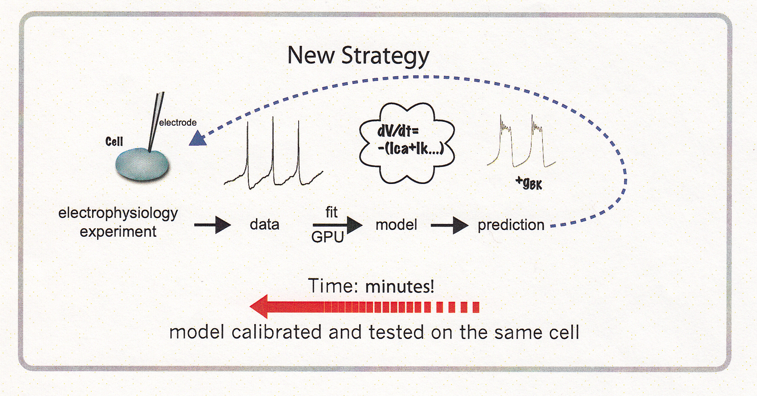
Our new approach

Slide 40
Thank you

