Slide 1
Understanding the Neural Basis of Birdsong in the Zebra Finch with the Help of Mathematical Modeling
Richard Bertram
Department of Mathematics and
Programs in Neuroscience and Molecular Biophysics
Florida State University, Tallahassee, FL.
Funding::
NSF IOS 1146607
West Virginia University, 2013

Slide 2
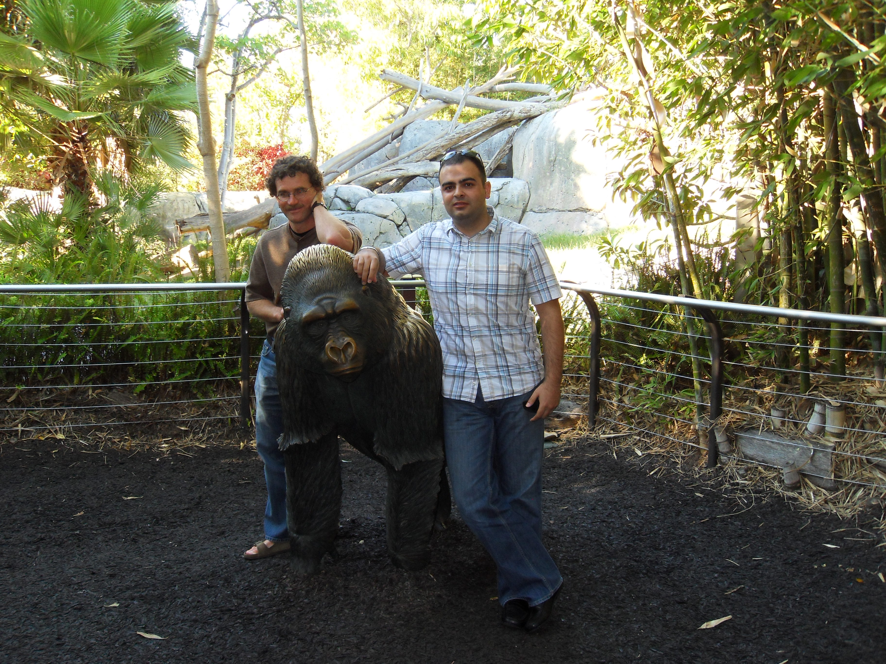

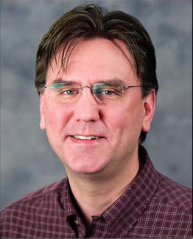
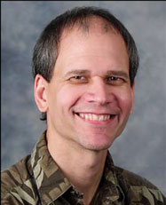


Arij Daou
Matthew Ross
Frank Johnson
Rick Hyson
Wei Wu
John Thompson

Slide 3
Why use mathematical modeling?
1. As an aid to the interpretation of experimental data.
2. Integration of multiple sets of experimental results.
3. Great for finding holes in our knowledge.
4. Ideal for making predictions. This is a powerful tool for experimental design.

Slide 4
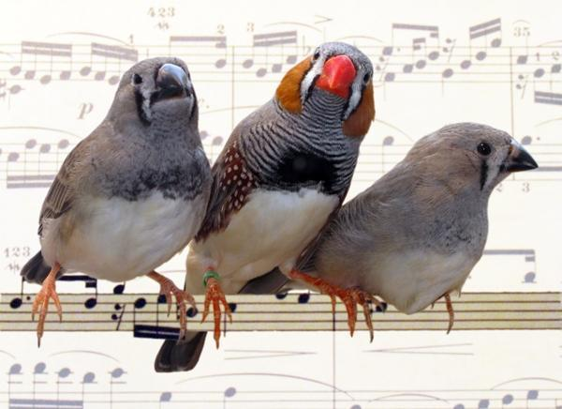

Slide 5


Slide 6
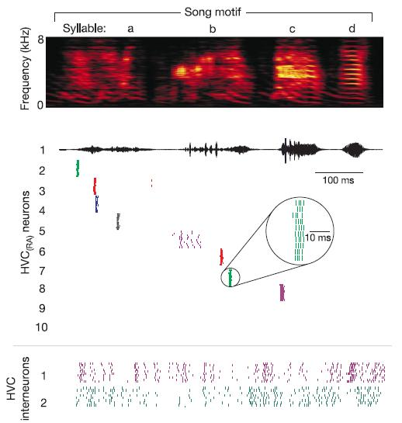
Adult male zebra finches sing a stereotyped song
Fourier analysis of the song, called a spectogram
Daou et al., J. Neurosci. Meth., 210:147, 2012

Slide 7
How did I get involved?
Frank Johnson, “I have a math question for you”

Slide 8

RB, “That’s not a math question,
that’s a statistics question!”

Slide 9
RB, “I recently met a statistician
named Wei Wu, let’s ask him…”

Slide 10
Song control system
HVC = proper name
RA = robust nucleus of the
arcopallium
LMAN = lateral magnocellular
nucleus
X = Area X
DLM = dorsolateral thalamus
Neurons within the telencephalon produce the neural
activity underlying the song.

Slide 11
What role does LMAN play in song learning?
Prevailing hypothesis in 2007: It provides error correction
Experimental test: Make a small microlesion to the HVC
to disrupt the song. If hypothesis is correct, then when
LMAN is ablated the song should not return to normal.

Slide 12
Song analysis in terms of scatter plots
Gray: before
microlesion
Black: after
microlesion
With LMAN
Without LMAN
Duration
Thompson et al., J. Neurosci., 27:12308, 2007

Slide 13
Return of song actually seems faster without LMAN, but how can we quantify this?
Treat the scatter plots as probability distributions. Then ask how
far the pre-microlesion distribution is from the post-microlesion
distribution on different days. Measure distance with the
Kellback-Leibler (KL) distance.
With LMAN
Wei Wu
Without LMAN
Time (days)
John Thompson
Thompson et al., J. Neurosci., 27:12308, 2007

Slide 14
Conclusion: LMAN does not play the role of an error corrector
Alternate hypothesis: LMAN provides random variation to the system
that is useful for the bird during development to explore its vocal
repertoire as it attempts to mimic the tutor’s song.

Slide 15
How are syllables encoded by neurons of the HVC?
spectogram
acoustic signal
precise timing
of HVC_{RA} neuron
bursts of electrical
activity
spiking during
10 renditions of
the motif
Hahnloser et al., Nature, 419:65, 2002
Long et al., Nature, 468:394, 2010

Slide 16
Goal: Construct network models that can produce HVC neural activity patterns during singing
HVC_{RA}: One burst per motif during the same syllable
HVC_{X}: Several bursts per motif, spread over several syllables
HVC_{INT}: Dense spiking mixed with bursting throughout motif

Slide 17
Example single cell ion fluxes
Ca²⁺
Ca²⁺
pump
K+ (BK)
fast
[Ca²⁺]
Ca²⁺
Ca²⁺
K+
Ca²⁺
Ca²⁺
Ca²⁺
Ca²⁺
Ca²⁺
KDR,SK
slow
Ca²⁺
Ca²⁺
leak
K⁺
K⁺
K⁺
K⁺
K⁺
K⁺
K⁺
K⁺
K⁺
K⁺

Slide 18
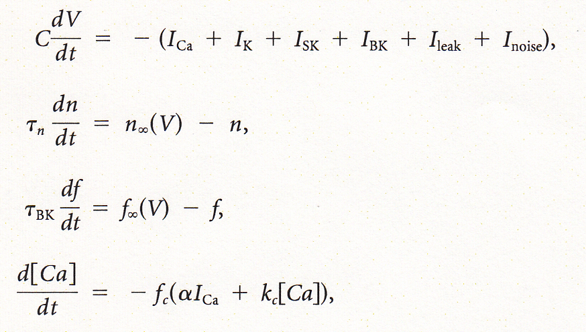
Hodgkin-Huxley-like equations
voltage
I_{K} activation
I_{BK} activation
cytosolic calcium
Ionic current have an Ohmic form, e.g.,

Slide 19

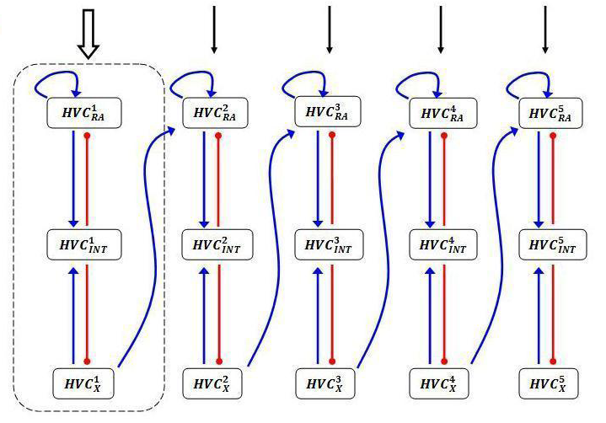
What architectures produce the correct HVC neuron activity patterns?
Network 1
Arij Daou

Slide 20
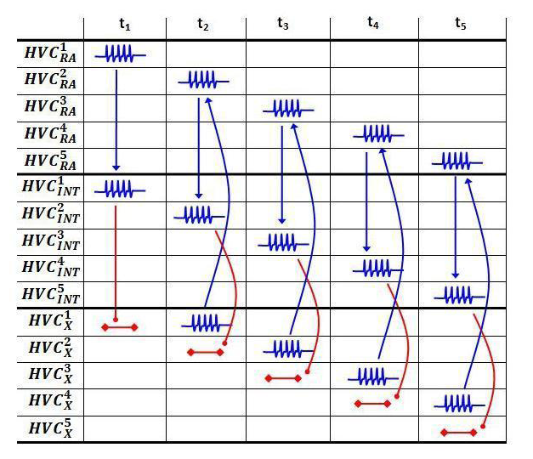
Activity pattern: network 1

Slide 21
Spiking patterns: network 1
4 motifs
1 motif
HVC_{RA} neurons
HVC_{INT}³
HVC_{X}³

Slide 22
Problem with network 1: not enough HVC_{INT} and HVC_{X} bursts per motif— develop more complex networks

Slide 23
Modeling paper submitted twice—rejected both times
Not enough data on individual neurons
Little evidence for rebound bursting
Reviewers uncomfortable with purely theoretical work
“There are no unsuccessful experiments. Every experiment
contains a lesson. If we stop right here, it is the man that is
unsuccessful, not the experiment”
Alexander Graham Bell

Slide 24
We need more single-cell data to build better single-cell models
HVC
Retrograde labeling
for HVC_{RA} neurons
Flourescent HVC_{RA}
neurons with pipette

Slide 25
Calibrate single-cell models to match the electrophysiology data
Data and model of an HVC_{X} neuron

Slide 26
Make model predictions—then test them
First “block” T-type
Ca²⁺ current
Next “block” the
h-current
HVC_{X} neuron

Slide 27
Make model predictions—then test them
First “block” T-type
Ca²⁺ current
Next “block” the
h-current
Mibrefradil blocks T-type
Ca²⁺ current
ZD 7288 blocks the
h-current
HVC_{X} neuron

Slide 28
After one year of work—models that are calibrated to the three cell types
Size of channel icon reflects size of maximum conductance

Slide 29
Next steps:
Connect the single-cell models together and look at
plausible network properties.
Do single-cell studies of juvenile birds to study how
channel distributions and roles change during song
learning.
Use the Dynamic-Clamp to inject model currents and
study the response.

Slide 30
Thank you!

