Slide 1
A Hybrid Experimental/Modeling Approach to Studying Pituitary Cell Dynamics
Richard Bertram
Department of Mathematics and
Programs in Neuroscience and Molecular Biophysics
Florida State University, Tallahassee, FL.
Funding: National Science Foundation
DMS1220063
Biodynamics 2013

Slide 2
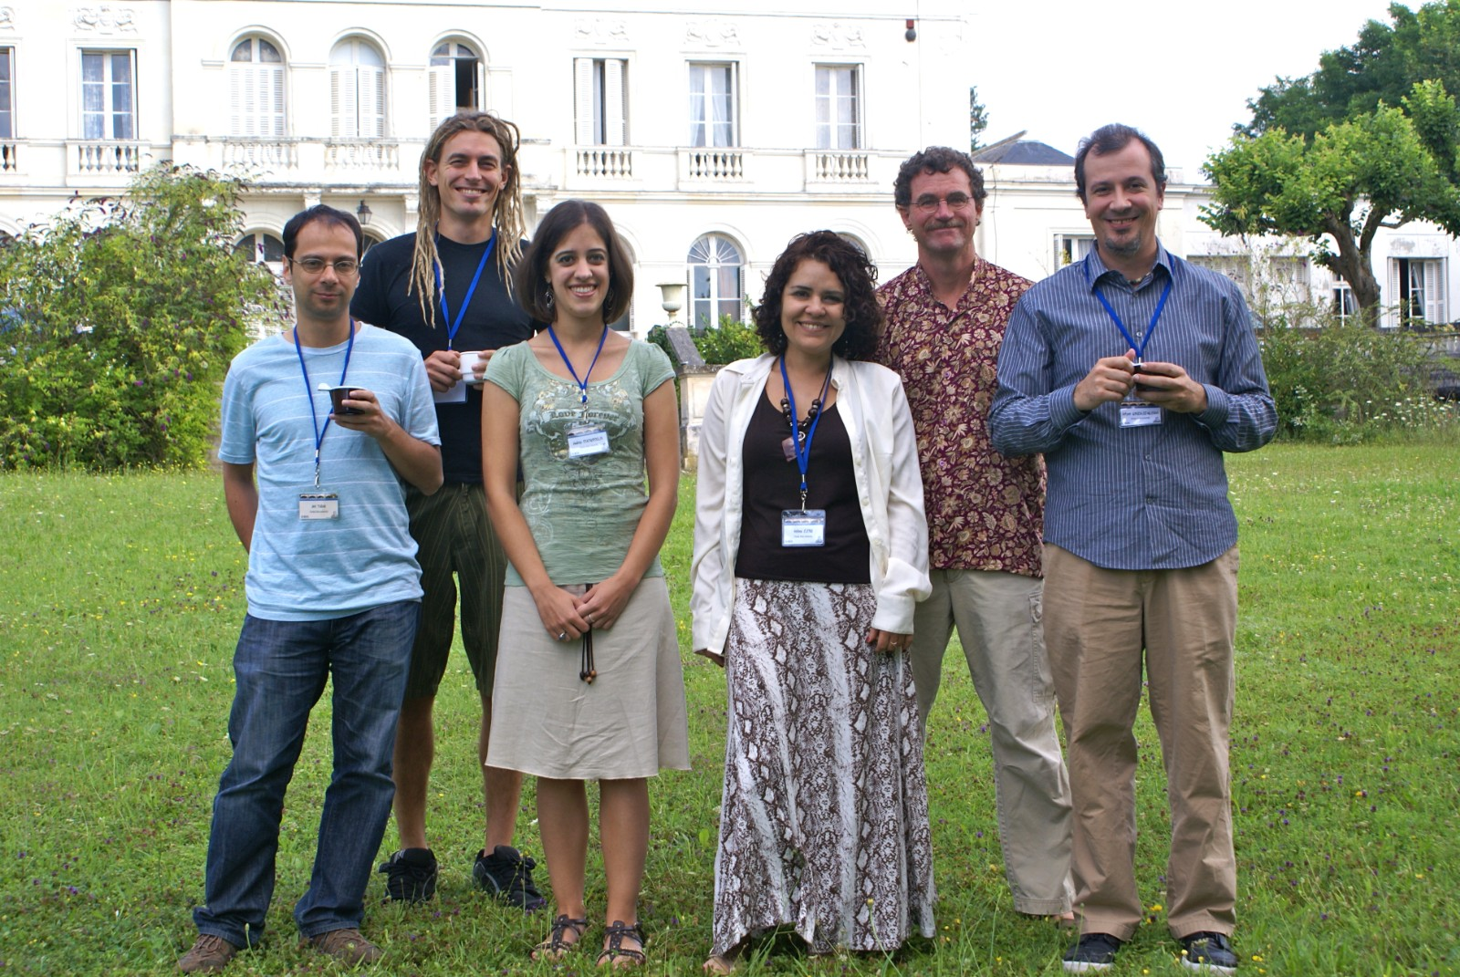

Joël Tabak
Patrick Fletcher
Maurizio Tomaiuolo
(Univ. Pennsylvania)

Slide 3
Five types of anterior pituitary endocrine cells
Lactotrophs: secrete prolactin
Somatotrophs: secrete growth hormone
Gonadotrophs: secrete luteinizing hormone and
follicle stimulating hormone
Corticotrophs: secrete ACTH
Thyrotrophs: secrete thyroid stimulating hormone

Slide 4
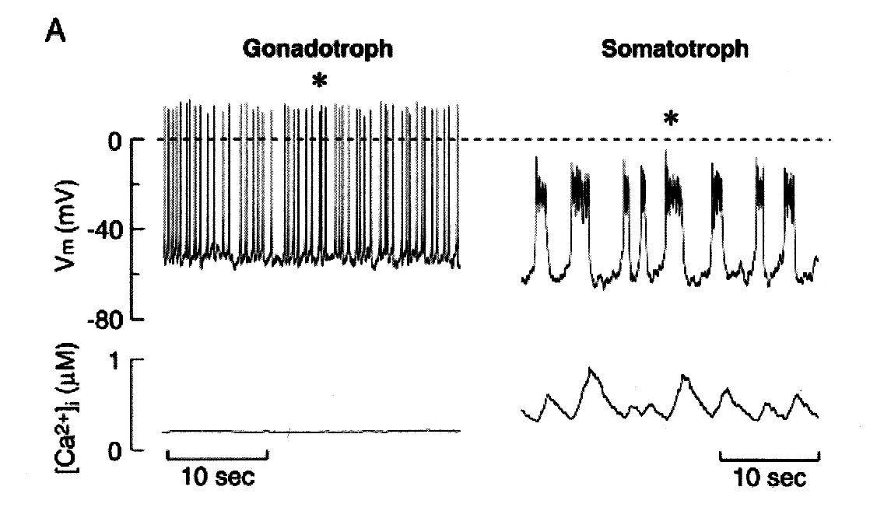
Goal
Use mathematical modeling and analysis to help
understand the electrical activity of the different
types of endocrine pituitary cells
Spiking, little
secretion
Bursting,
much more
secretion
Van Goor et al., J. Neurosci., 2001:5902, 2001
What makes pituitary cells burst and secrete?

Slide 5
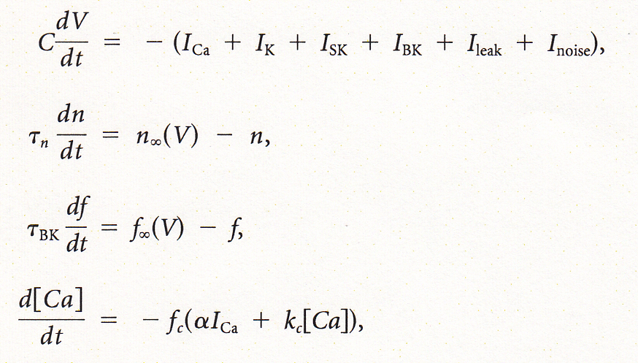
Equations
voltage
I_{K} activation
I_{BK} activation
cytosolic calcium
Ionic current have an Ohmic form, e.g.,
Conductance and time constants are all parameters.
There are more parameters in the equilibrium functions.

Slide 6
Pituitary cells are very heterogeneous
The mix of ionic currents within a single cell type is
highly variable, as shown with the GH4C1 cell line…
Cell 1
Cell 2
Cell 3

Slide 7
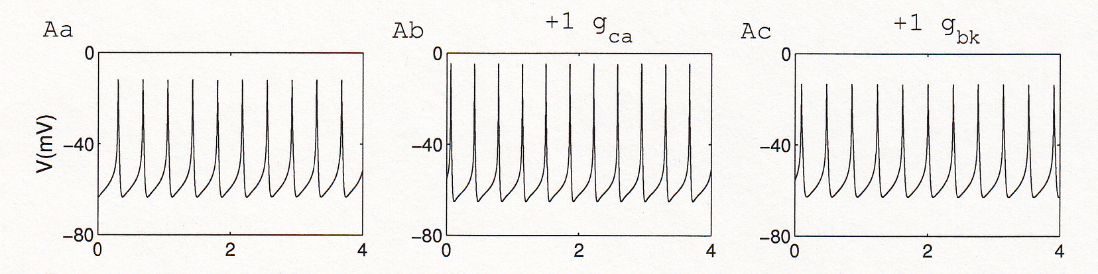
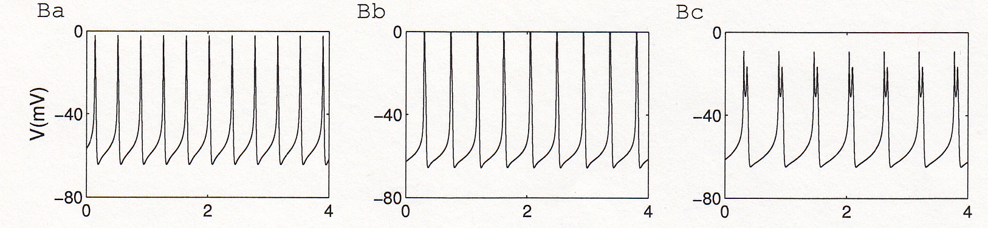
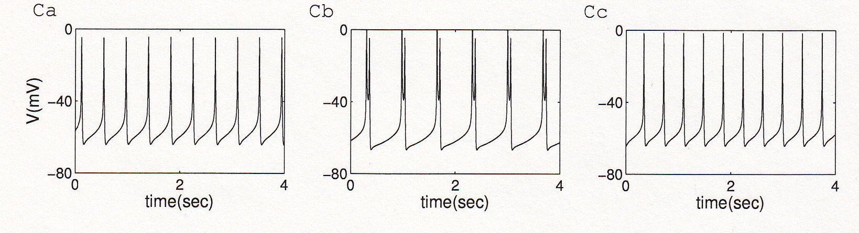
Why does heterogeneity matter?
One spiking model
cell
Another spiking
model cell
A third spiking
model cell
Tomaiuolo et al., Biophys. J., 103:2021, 2012

Slide 8
What we’d like to do…
Parameterize the model to an individual cell,
while still patched onto that cell. Then different
cells will have different parameter vectors.

Slide 9
Set parameters to fit features of the voltage trace,
rather than the voltage trace itself
peaks
amplitude
V (mV)
silent
active
period
min
Time (sec)

Slide 10
Also fit voltage clamp data
Maximize
where

Slide 11
Optimization using a genetic algorithm
p₂
p₂
selection
p₁
p₁
replication with mutation
p₂
repeat
p₁

Slide 12

We need rapid calibration, so use a
Programmable Graphics Processing Unit (GPU)
Cost < $ 1000

Slide 13
Feature planes can be rapidly computed
100x100 grid
10,000 simulations
Simulation time=70 sec each
Total computation time=20 sec

Slide 14
Example: Calibrate, predict, and test
The model (red) is fit to a bursting Gh4 cell (black)
Notes:
Best fit model simulation. gBK=1, tauBK=5

Slide 15
Feature plane for BK conductance and time constant
Best fit to bursting data
Block BK current
Notes:
Star is the parameters used for fit. The rest are predictions. White points: qualitative behaviour matches the real cell at these combinations (plus a few more actually) – however, the bursts at gBK=4 were quite a bit longer in reality.

Slide 16
BK current blocked in cell with paxillin
Actual cell (black) and model (red) convert from bursting to spiking
Notes:
Best fit model with gBK reduced to 0. Just like the cell, the model now spikes.

Slide 17
Feature plane for BK conductance and time constant
Best fit to bursting data
Double BK time constant
Notes:
Star is the parameters used for fit. The rest are predictions. White points: qualitative behaviour matches the real cell at these combinations (plus a few more actually) – however, the bursts at gBK=4 were quite a bit longer in reality.

Slide 18
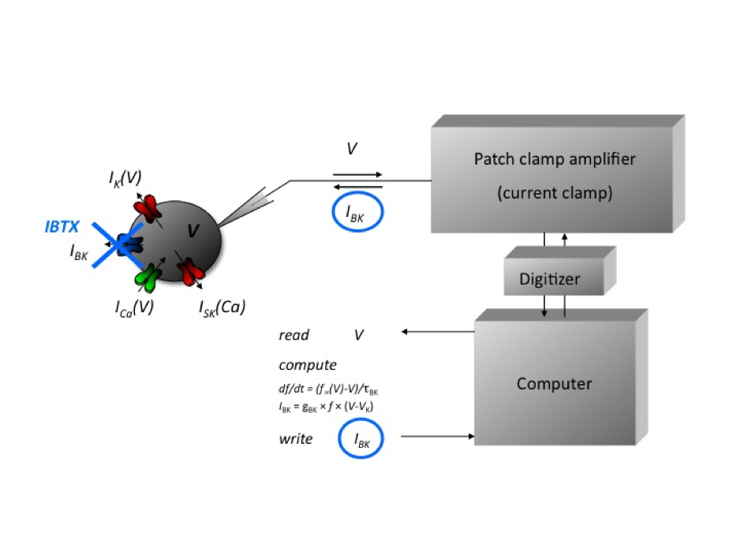
The Dynamic Clamp: a tool for adding a model current to a real cell

Slide 19
BK current added via D-clamp, with τ_{BK}=10 ms
Black=cell
Red=model
Adding BK current with slow activation converts bursting to spiking
Notes:
Best fit model with tauBK increased to 10. Just like the cell, the model now spikes.

Slide 20
Feature plane for BK conductance and time constant
Best fit to bursting data
Increase BK conductance
Notes:
Star is the parameters used for fit. The rest are predictions. White points: qualitative behaviour matches the real cell at these combinations (plus a few more actually) – however, the bursts at gBK=4 were quite a bit longer in reality.

Slide 21
BK conductance added to a bursting cell
Black=cell
Red=model
Bursting persists, with more spikes per burst
Notes:
Best fit model with gBK increased to 4 (tau=5). Just like the cell, the model still bursts

Slide 22
Prediction: Reducing K(dr) conductance increases the burstiness
Diameter: active phase duration
Color: number of spikes per active phase
Teka et al., J. Math. Neurosci., 1:12, 2011

Slide 23
Prediction tested using D-clamp
Control cell
Subtract some K(dr)
current
Subtract more K(dr)
current
Summary
Bertram et al., in press

Slide 24
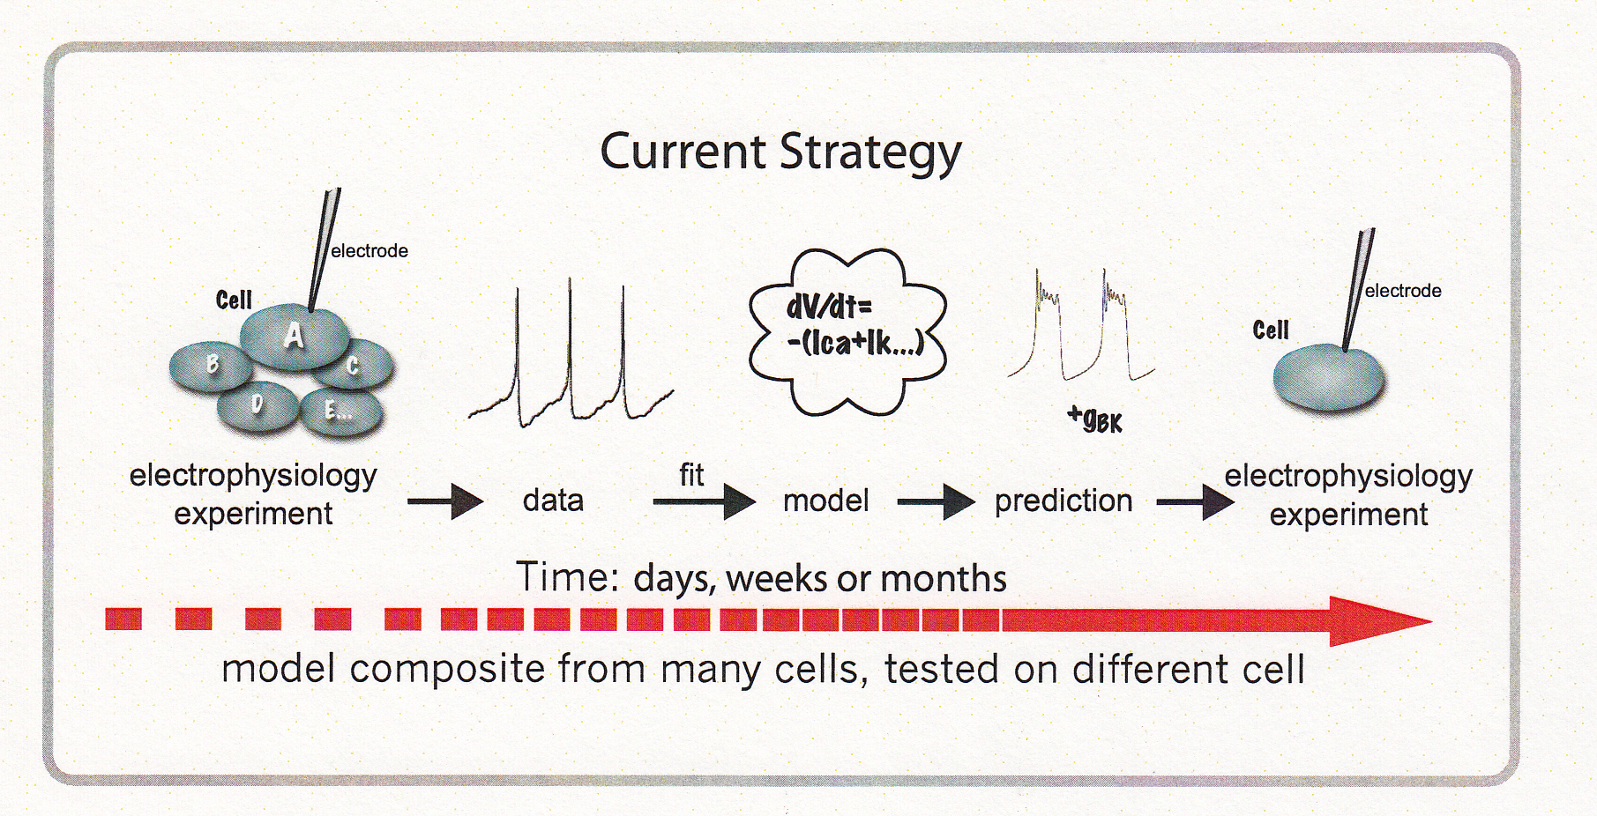
The “traditional” approach

Slide 25
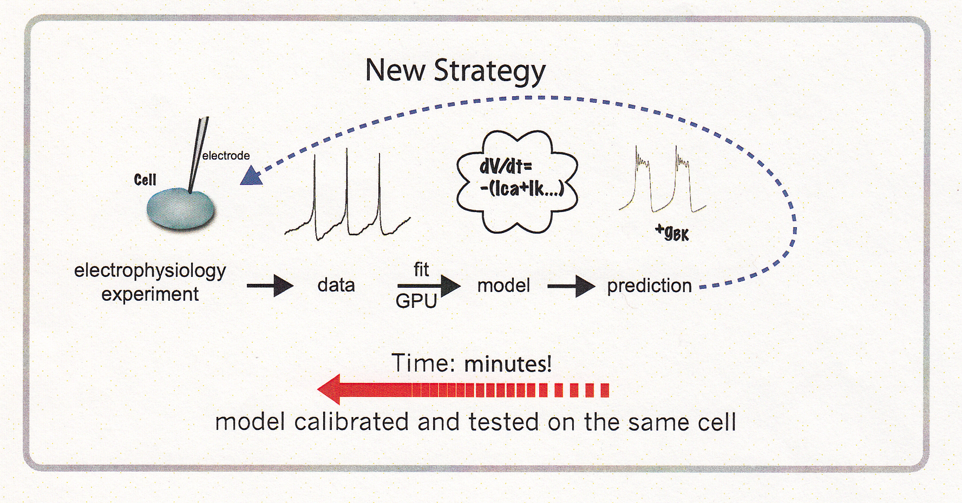
Our new approach

Slide 26
Thank you

