Slide 1
A Hybrid Approach to Understanding Cell Dynamics
Richard Bertram
Department of Mathematics and
Programs in Neuroscience and Molecular Biophysics
Florida State University, Tallahassee, FL.
Funding: NIH DK043200
NSF DMS1220063
Mathematical Biosciences Institute, 2013

Slide 2
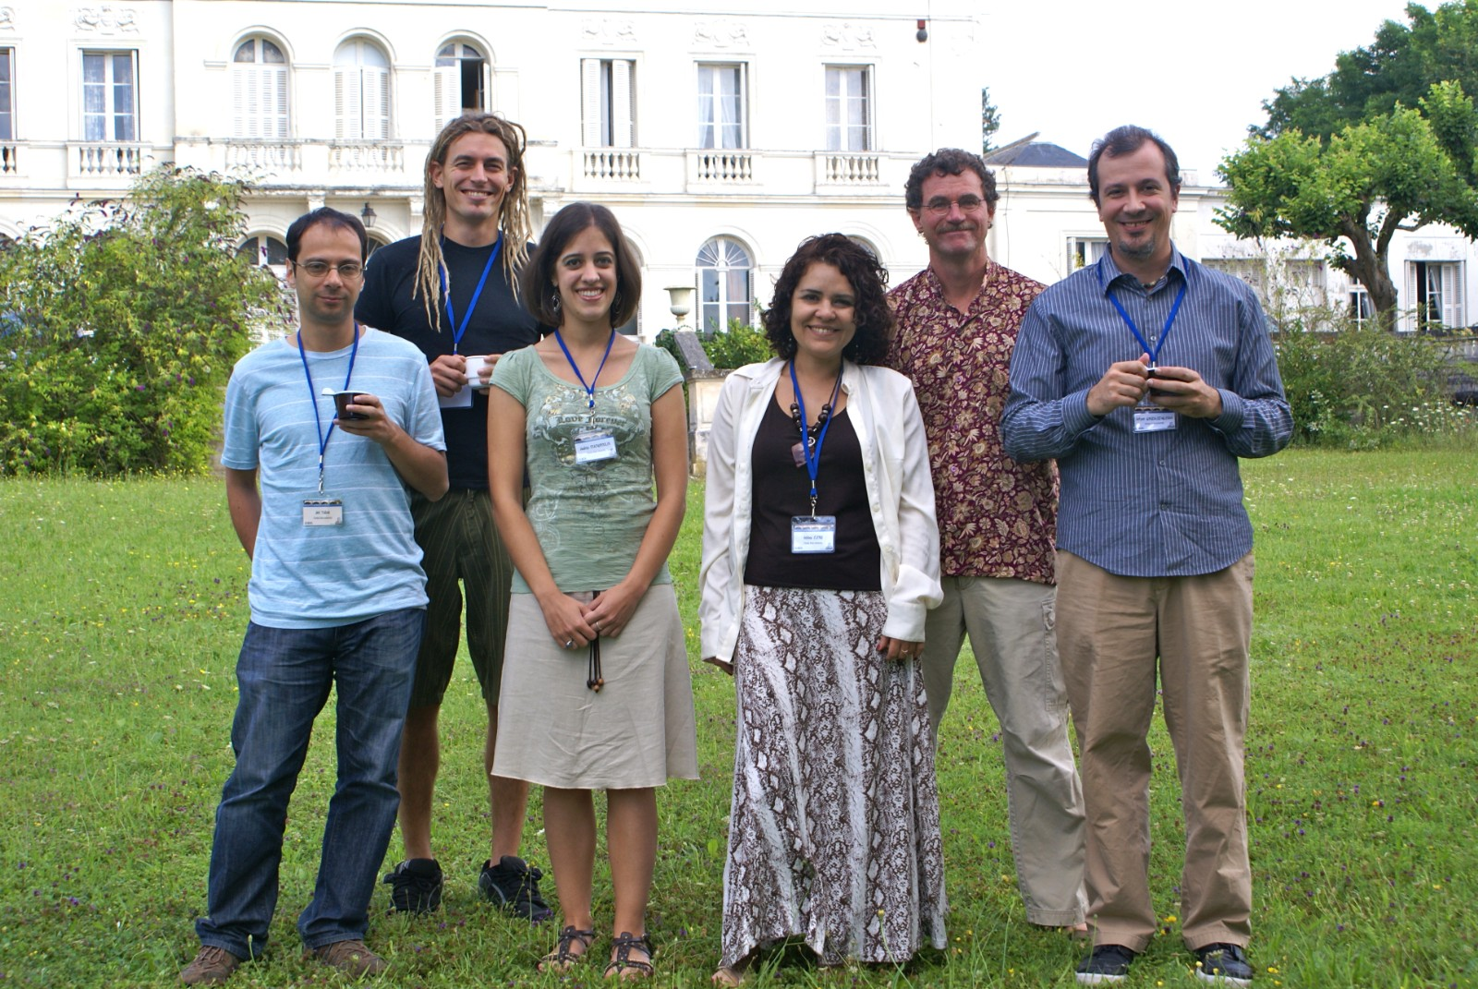

Coworkers on the project
Joël Tabak
Patrick Fletcher
Maurizio Tomaiuolo
(Univ. Pennsylvania)

Slide 3
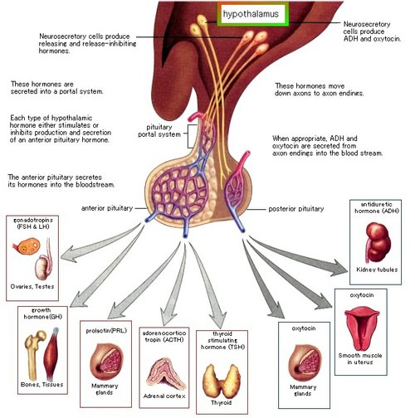
Hypothalamus and Pituitary

Slide 4
Five types of anterior pituitary cells
Lactotrophs: secrete prolactin
Somatotrophs: secrete growth hormone
Gonadotrophs: secrete luteinizing hormone and
follicle stimulating hormone
Corticotrophs: secrete ACTH
Thyrotrophs: secrete thyroid stimulating hormone

Slide 5
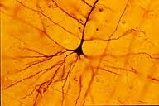
A cell with considerable spatial structure

Slide 6
A cell with considerable spatial structure

Slide 7
Thanks to Arturo Gonzalez-Iglesias, Jose Arias-Cristanch, and Ruth Cristancho-Gordo
Immunocytochemistry for prolactin, growth hormone,
and leutinizing hormone.

Slide 8
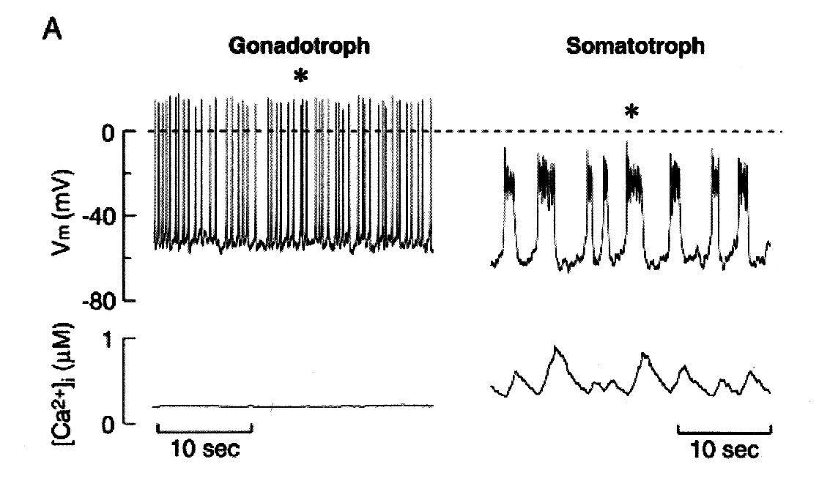
Electrical excitability
Pituitary cells are electrically excitable, but
secretion only occurs when the cells burst
Spiking
Bursting
Low Ca²⁺, so
little secretion
More Ca²⁺, so
more secretion
Van Goor et al., J. Neurosci., 2001:5902, 2001

Slide 9
Ca²⁺
Ca²⁺
pump
K+ (BK)
fast
[Ca²⁺]
Ca²⁺
Ca²⁺
Ca²⁺
K+
Ca²⁺
Ca²⁺
Ca²⁺
Ca²⁺
KDR,SK
slow
Ca²⁺
Ca²⁺
leak
K⁺
K⁺
K⁺
K⁺
K⁺
K⁺
K⁺
K⁺
K⁺
K⁺

Slide 10
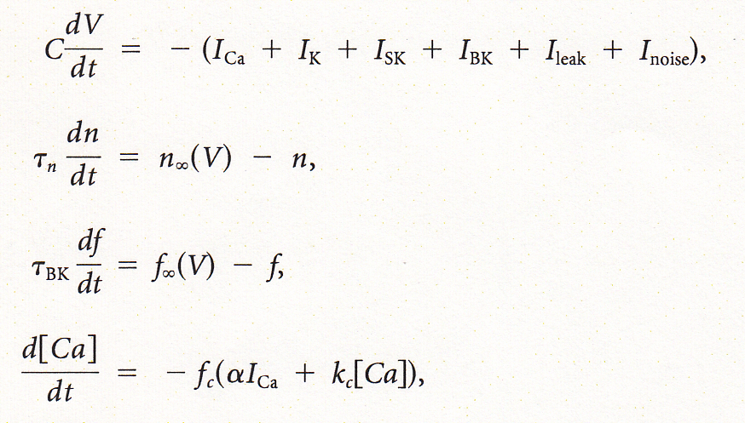
Equations
voltage
I_{K} activation
I_{BK} activation
cytosolic calcium
Ionic currents have an Ohmic form, e.g.,

Slide 11

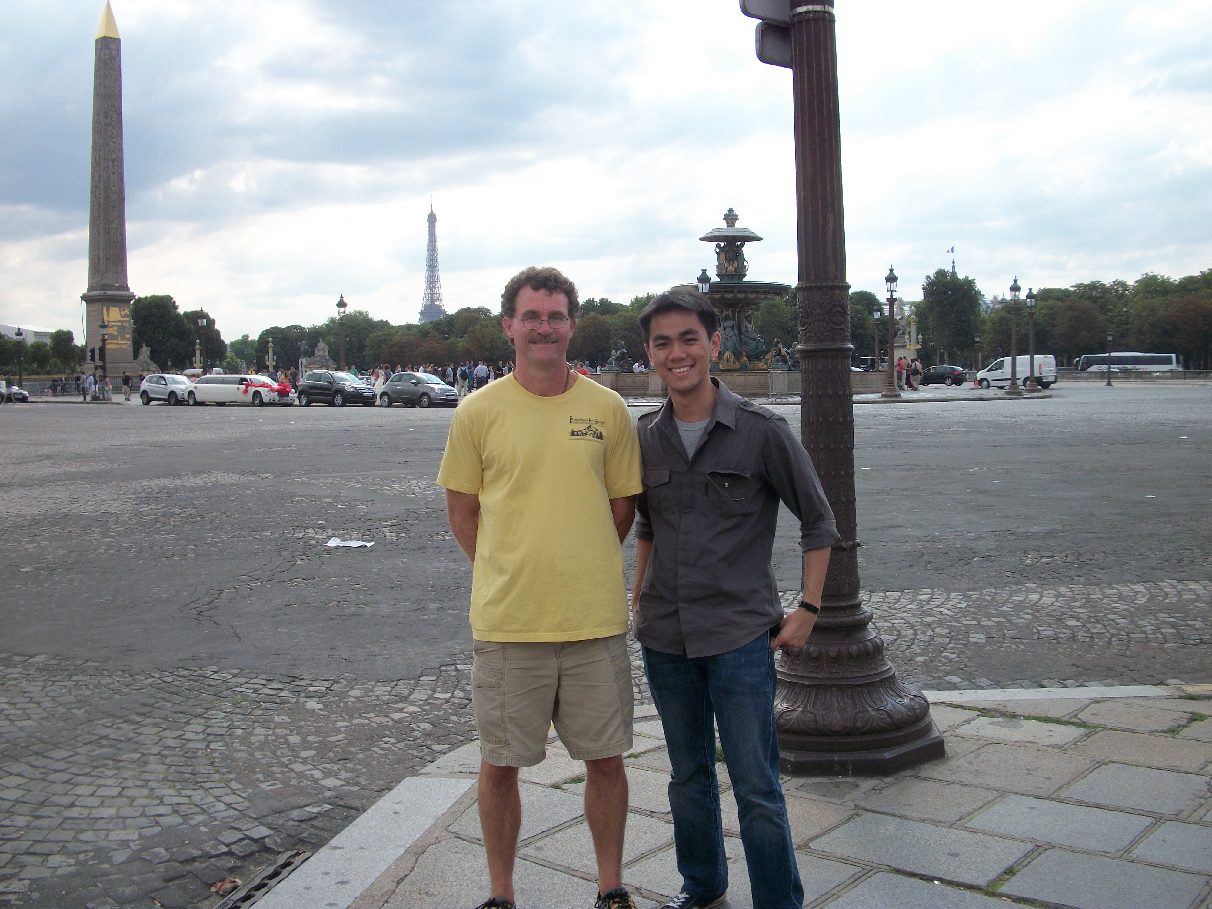
What are the dynamics underlying bursting in pituitary cells?
Joël Tabak
Wondimu Teka
Martin
Wechselberger
Theo Vo

Slide 12
Variables change on different time scales
Several fast/slow decompositions can be utilized

Slide 13
Approach 1: A single slow variable
Works well for square-wave bursting

Slide 14
Approach 1: A single slow variable
But not for pituitary bursting

Slide 15
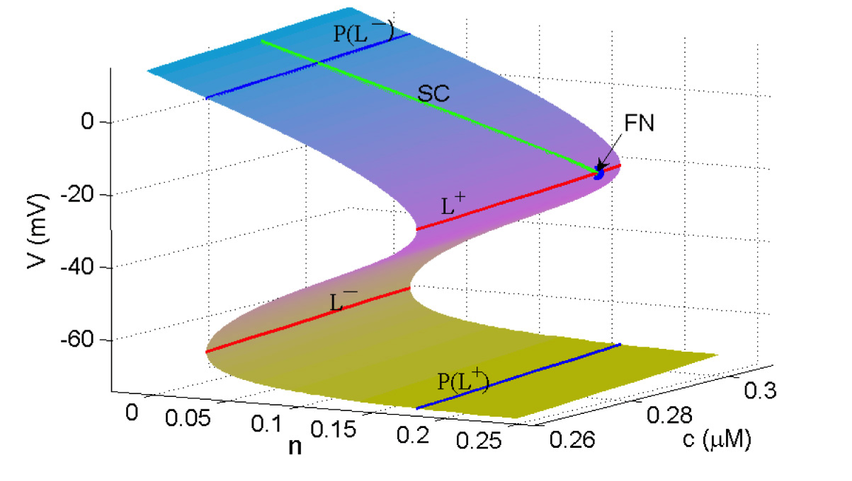
Approach 2: Two slow variables
In singular limit, the trajectory moves along a folded surface
where V and f are at quasi-equilibrium
RHS of V-ODE:
Critical manifold:
FN = folded node singularity

Slide 16
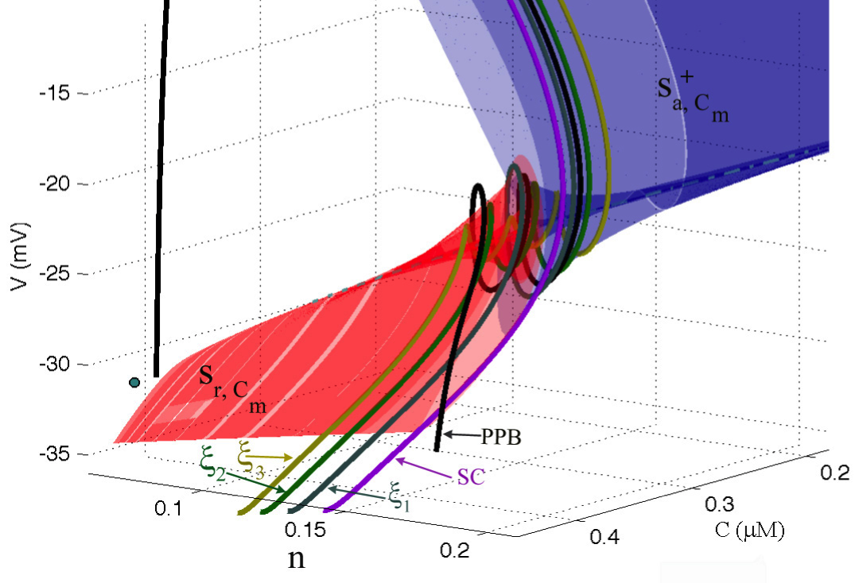
Away from the singular limit the slow manifold becomes twisted near the FN
The “spikes” of the bursts are small rotations of the
burst trajectory that occur due to the presence of a
folded node singularity in the slow subsystem.
Bursting orbit
Secondary
canards

Slide 17
The theoretical work helps us understand simulations and make better predictions

Slide 18
Prediction: Adding BK conductance increases the burstiness
Diameter: active phase duration
Color: number of spikes per active phase
Teka et al., J. Math. Neurosci., 1:12, 2011

Slide 19
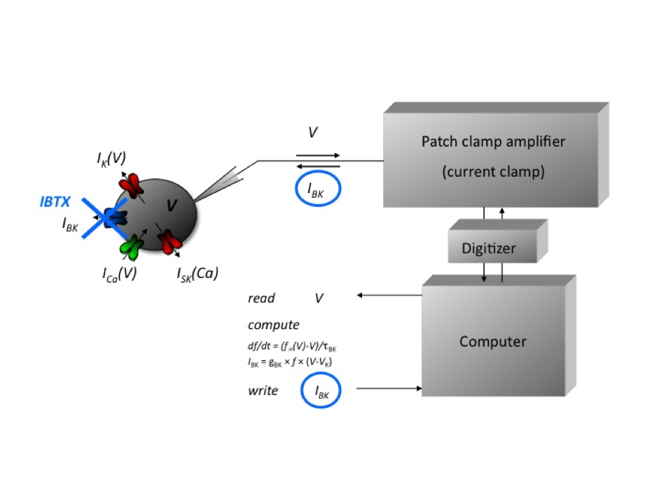
The Dynamic Clamp: a tool for adding a model current to a real cell

Slide 20
Prediction tested using D-clamp
BK pharmacologically blocked
Add back some BK current
with D-clamp
Add more BK current
Summary
Bertram et al., in press

Slide 21
Prediction: Reducing K(dr) conductance increases the burstiness
Diameter: active phase duration
Color: number of spikes per active phase
Teka et al., J. Math. Neurosci., 1:12, 2011

Slide 22
Prediction tested using D-clamp
Control cell
Subtract some K(dr)
current
Subtract more K(dr)
current
Summary
Bertram et al., in press

Slide 23
Problem: since we don’t know true parameter values and the cells are heterogeneous our ability to make predictions is limited

Slide 24
Pituitary cell behavior is heterogeneous
The mix of ionic currents within a single cell type is
highly variable, as shown with the GH4C1 cell line
Cell 1
Cell 2
Cell 3

Slide 25
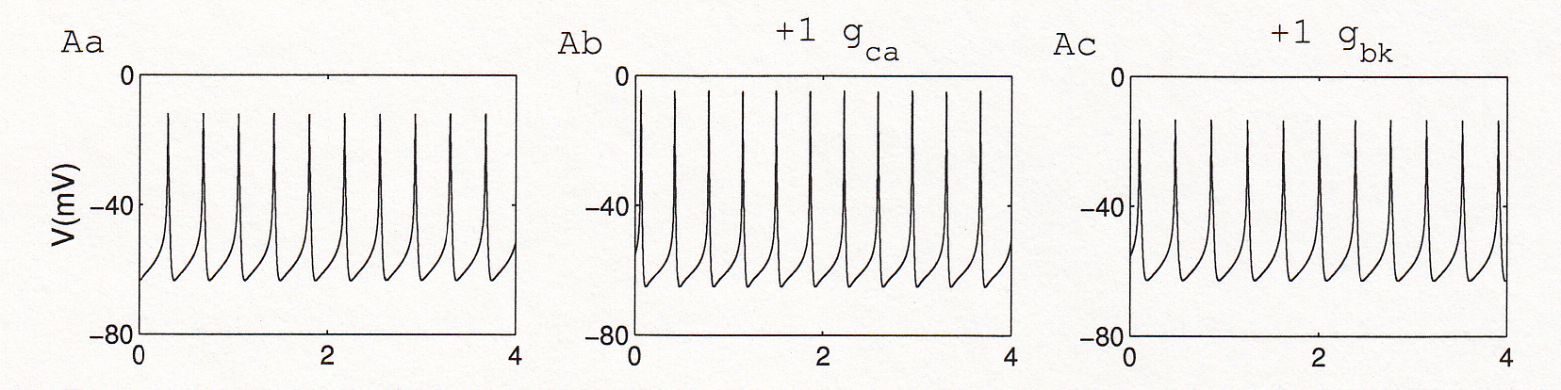
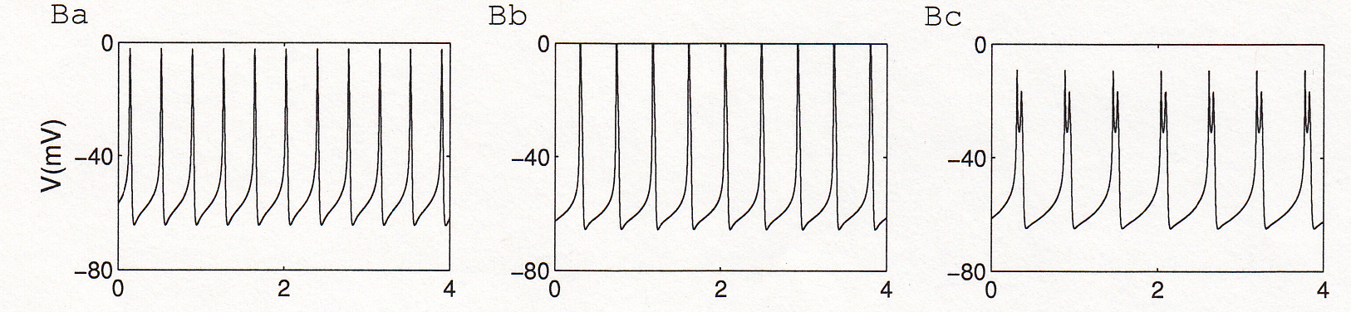
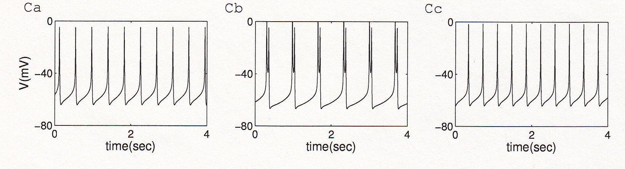
Why does this matter?
One spiking model
cell
Another spiking
model cell
A third spiking
model cell
Tomaiuolo et al., Biophys. J., 103:2021, 2012

Slide 26
What we’d like to do…
Parameterize the model to an individual cell,
while still patched onto that cell. Then different
cells will have different parameter vectors.

Slide 27
Set parameters to fit features of the voltage trace,
rather than the voltage trace itself
peaks
amplitude
V (mV)
silent
active
period
min
Time (sec)

Slide 28
Feature fitness function
F=fitness function
m_{j}=model feature
d_{j}=data feature
c_{j}=feature weight
σ_{j}=feature scaling

Slide 29
Also fit voltage clamp data

Slide 30
Voltage clamp fitness function
Im_{k}=current from model
Id_{k}=current from data
λ_{k}=scaling factor
and
Maximize
where

Slide 31
Model simulations fit to the actual GH4 cell
Optimization over the 5 parameters g_{Ca}, g_{K}, g_{SK}, g_{l}, and k_{c}
Notes:
Fitness near the best fit model (star), in the gK, gBK plane.
Note: gBK was fixed at a value of 1 for the fit, while other parameters were allowed to vary (gCA, gK, gSK, gLeak, and kc – the calcium pump rate)

Slide 32
Fitness landscape for a bursting cell
Optimization over the 5 parameters g_{Ca}, g_{K}, g_{SK}, g_{l}, and k_{c}
Star=best fit
Notes:
Fitness near the best fit model (star), in the gK, gBK plane.
Note: gBK was fixed at a value of 1 for the fit, while other parameters were allowed to vary (gCA, gK, gSK, gLeak, and kc – the calcium pump rate)

Slide 33

To construct the fitness landscape and find the optimum we use a Graphics Processing Unit (GPU)
Programmable
Graphics Processing Unit
One simulation takes 3.7 s
10,000 simulations take 18 s
Most recent model is
GTX 680 and Titan
Cost < $ 1000

Slide 34
Feature planes can be rapidly computed
and used to make predictions
100x100 grid
10,000 simulations
Simulation time=70 sec each
Total computation time=18 sec

Slide 35
Prediction 1
Decreasing g_{BK} should convert bursting to spiking

Slide 36
Before
Notes:
Fitness near the best fit model (star), in the gK, gBK plane.
Note: gBK was fixed at a value of 1 for the fit, while other parameters were allowed to vary (gCA, gK, gSK, gLeak, and kc – the calcium pump rate)

Slide 37
Testing Prediction 1 with BK blocker
Black=data (w/blocker)
Red=model (g_{BK}=0)

Slide 38
Prediction 2
Increasing the BK time constant (slowing down activation) should
convert bursting to spiking

Slide 39
Before
Notes:
Fitness near the best fit model (star), in the gK, gBK plane.
Note: gBK was fixed at a value of 1 for the fit, while other parameters were allowed to vary (gCA, gK, gSK, gLeak, and kc – the calcium pump rate)

Slide 40
Testing Prediction 2 with Dynamic Clamp
ms
Black=data
Red=model

Slide 41
Prediction 3
ms
Increasing g_{BK} increases the burst duration

Slide 42
Before
Notes:
Fitness near the best fit model (star), in the gK, gBK plane.
Note: gBK was fixed at a value of 1 for the fit, while other parameters were allowed to vary (gCA, gK, gSK, gLeak, and kc – the calcium pump rate)

Slide 43
Testing Prediction 3 with Dynamic Clamp
g_{BK}=4 nS
Black=data
Red=model

Slide 44
Algorithm for calibrating and testing predictions
Calibrate model
Make predictions
Test prediction
correct
incorrect
Test next prediction
Recalibrate
You have one hour

Slide 45
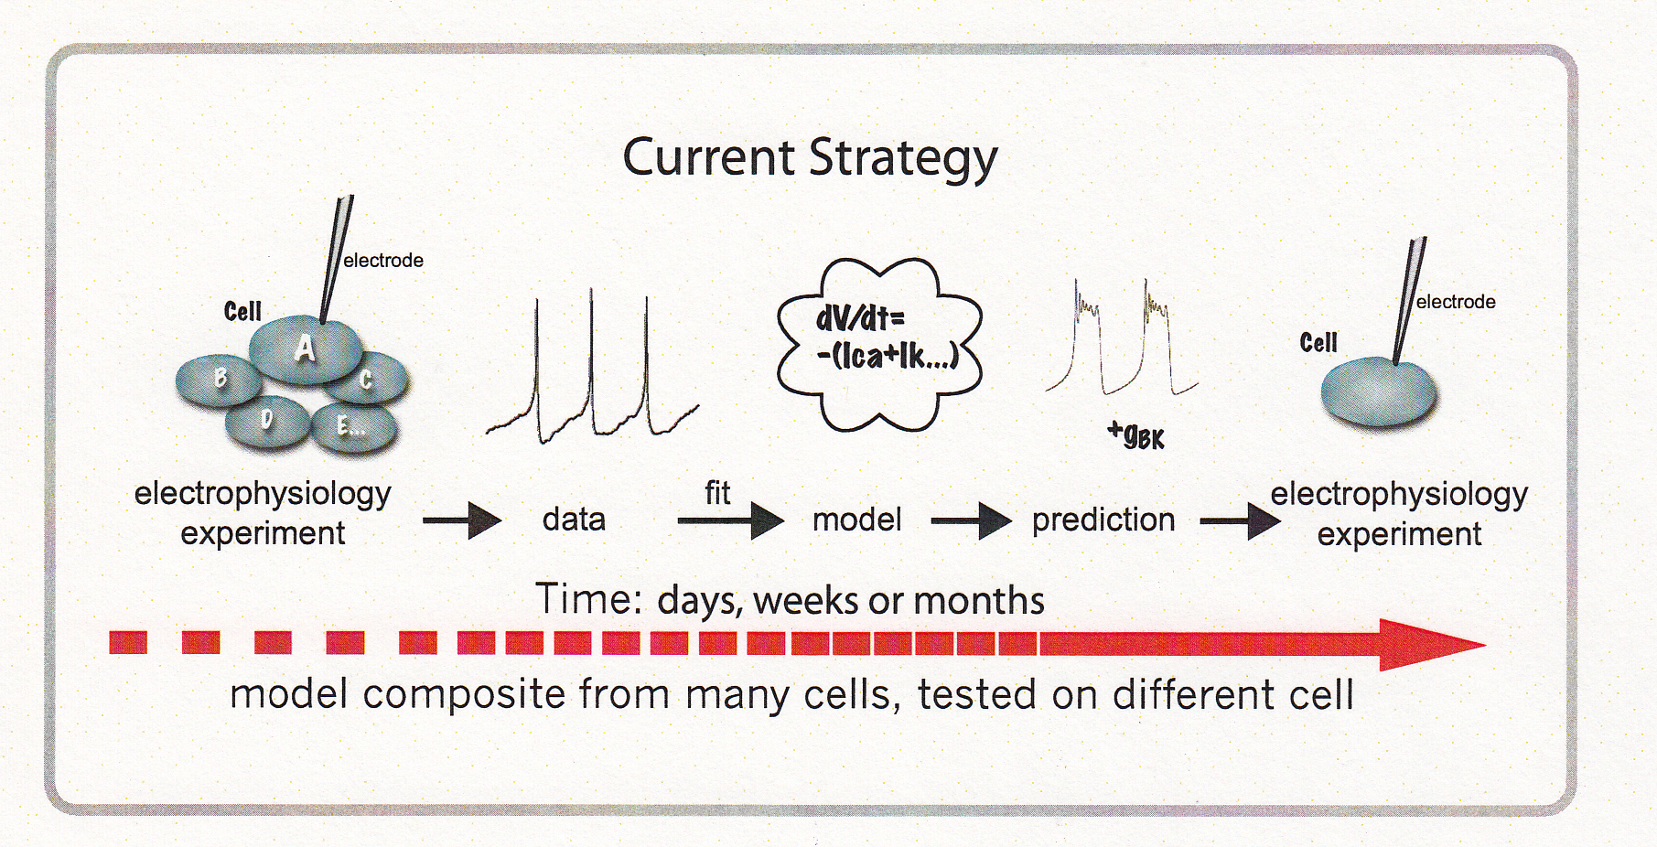
The “traditional” approach

Slide 46
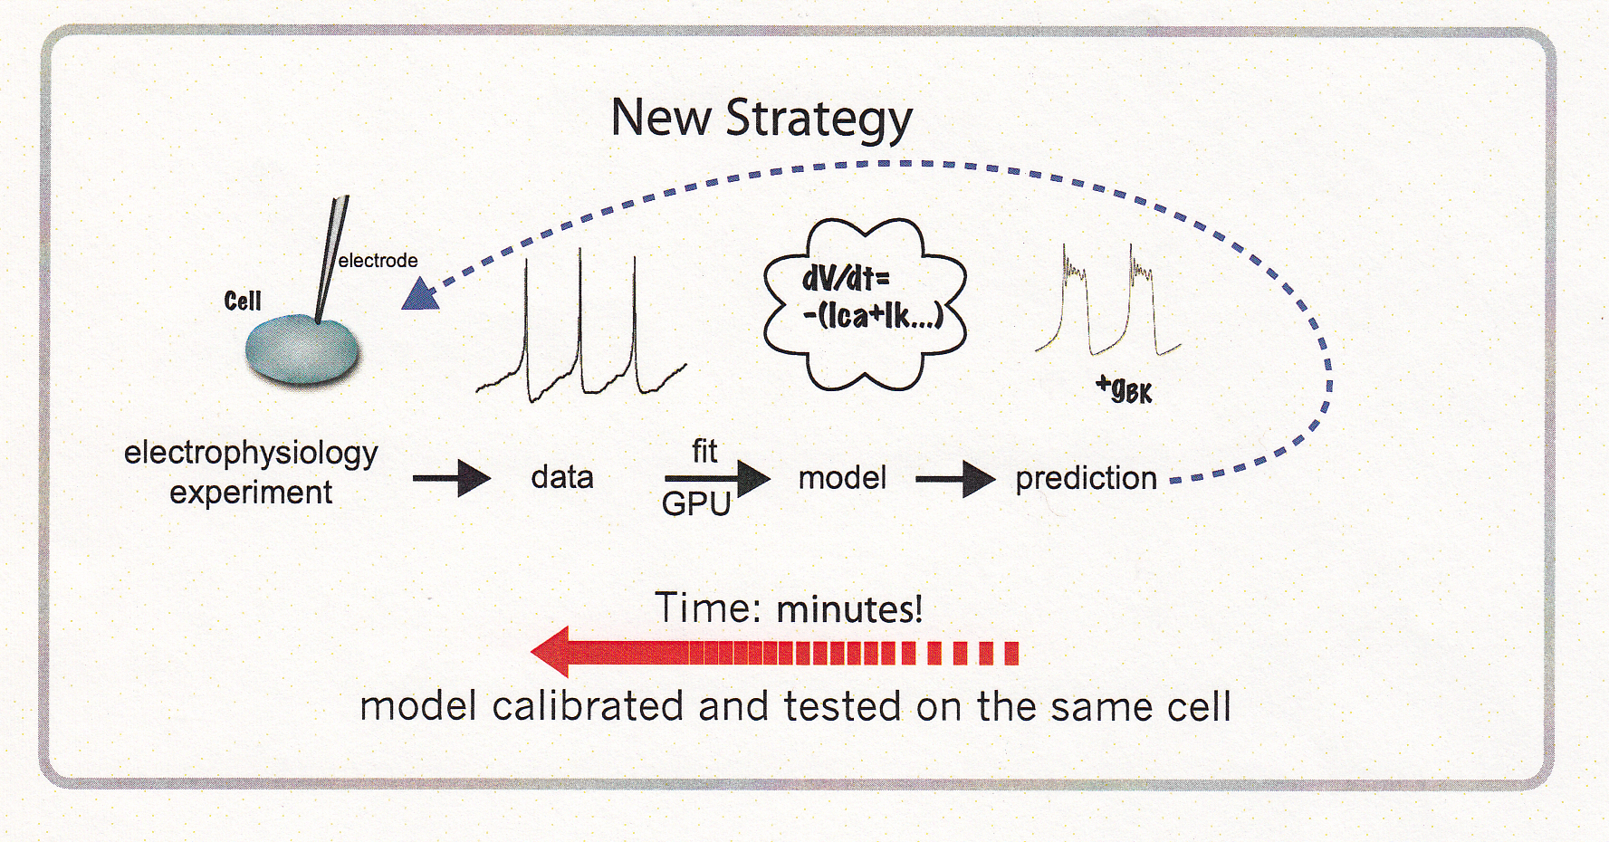
Our new approach

Slide 47
Thank you

