Slide 1
Using Mathematical Models to Determine the Source of Heterogeneity in Cellular Calcium Dynamics
Richard Bertram
Department of Mathematics and
Programs in Neuroscience and Molecular Biophysics
Florida State University, Tallahassee, FL.
Funding: National Institutes of Health
NIDDK 43200
SIAM Life Sciences 2014

Slide 2


Arturo Gonzalez-Iglesias
Joël Tabak
Maurizio Tomaiuolo
(High Performance
Computing Institute,
Frederick, MD)

Slide 3
Thanks to Arturo Gonzalez-Iglesias, Jose Arias-Cristanch, and Ruth Cristancho-Gordo
Immunocytochemistry for prolactin, growth hormone,
and leutinizing hormone.

Slide 4
Secretion is regulated by a number of factors
Neurohormones released by the hypothalamus as well
as hormones released from the pituitary gland and other
glands regulate secretion from the different pituitary cells.
VIP=vasoactive intestinal polypeptide
TRH=thyrotropin releasing hormone

Slide 5
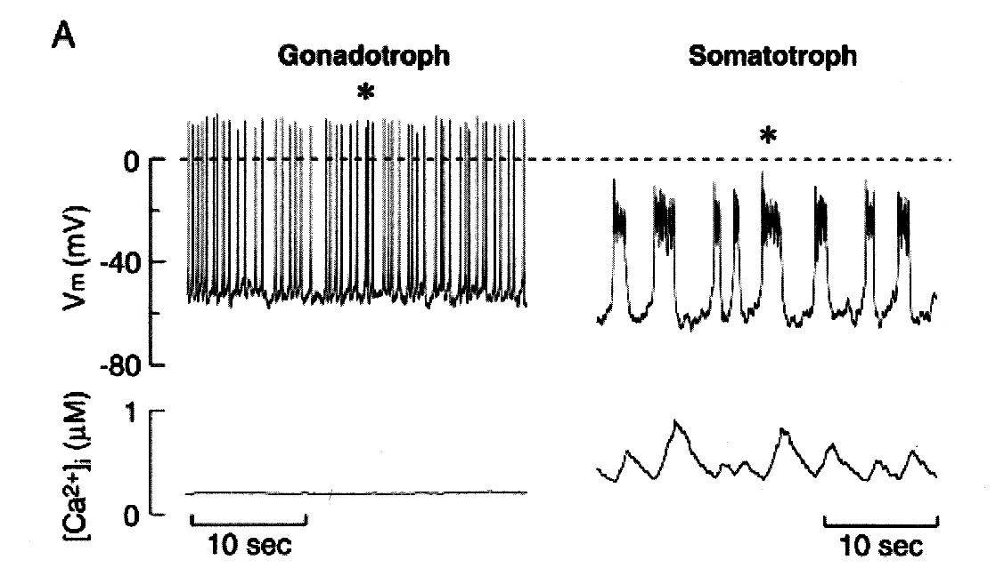
Calcium-evoked exocytosis: the mechanism for secretion
Hormone secretion is evoked by elevations in the
level of intracellular calcium.
Spiking, little
secretion
Bursting,
much more
secretion
Higher mean
calcium
Van Goor et al., J. Neurosci., 2001:5902, 2001

Slide 6
Pituitary cells are very heterogeneous
The mix of ionic currents within a single cell type is
highly variable, as shown with the GH4C1 cell line
Cell 1
Cell 2
Cell 3

Slide 7
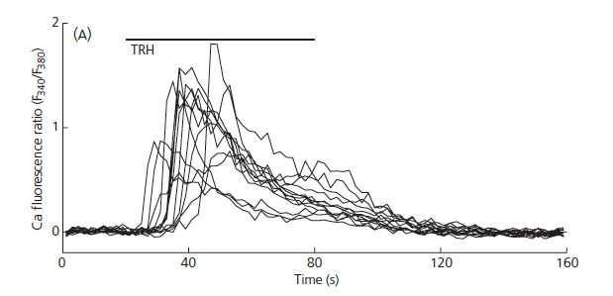
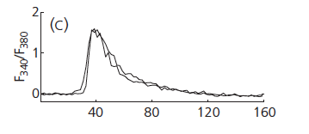
Their response to TRH is also very heterogeneous
Variable response of different lactotrophs to TRH application.
Similar responses to
two applications of
TRH in same cell.

Slide 8
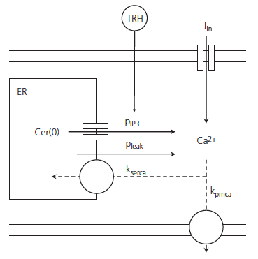
What is the source of the heterogeneity?
The calcium subsystem

Slide 9
Central idea: Use a model to determine the most likely
source of heterogeneity in the calcium response to TRH
by examining the influence of parameter heterogeneity

Slide 10
Two-compartment model
Cytosolic free calcium
Quasi-equilibrium
approximation
Free calcium in the
endoplasmic reticulum

Slide 11
Two-compartment model
Linear ODE
Solution
Decay rate:
Observable:

Slide 12
Simulation of TRH
Decay rate:
Observable:

Slide 13
Determine response features

Slide 14
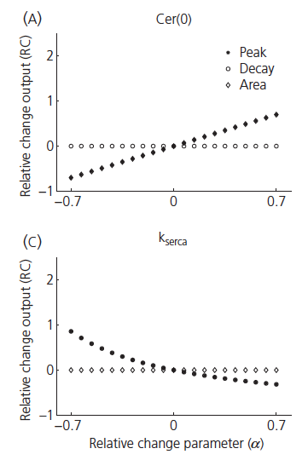
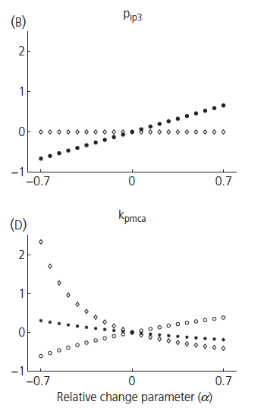
Dependence of features on parameters

Slide 15
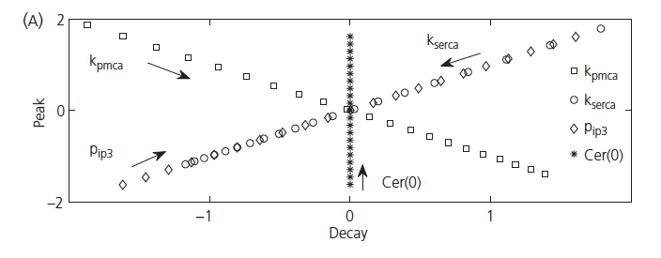
Model sensitivity analysis in a feature plane

Slide 16
Model sensitivity analysis in a feature plane

Slide 17
Model sensitivity analysis in a feature plane

Slide 18
Can we do this sensitivity analysis with actual cells?
No

Slide 19
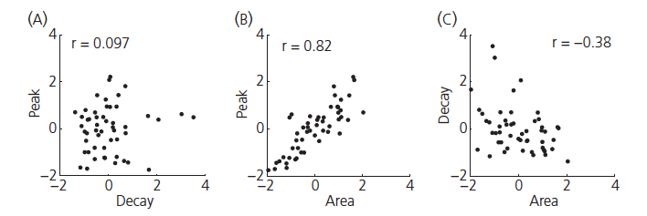
What can we do?
Record calcium
responses from many
cells and…
make feature scatter plots

Slide 20
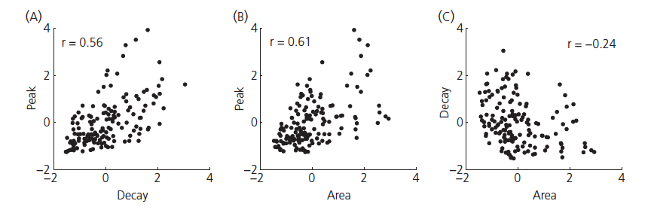
Now do this with the model
All parameters chosen from a uniform distribution ±50% of default
Data

Slide 21
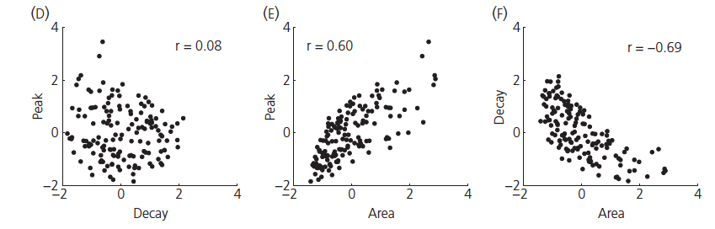
Assume greater variation in plasma membrane pump rate
All parameters chosen from a uniform distribution ±25% of default,
except k_{pmca}, chosen ±50% of default.
Data

Slide 22
But Wait, There’s More!
Similar approach can be used to study variability of other
systems, such as the electrical activity of lactotrophs
Thanks to Patrick Fletcher

Slide 23
Conclusions
Heterogeneity in the calcium response pattern is
consistent with greater variability in either the plasma
membrane calcium pump rate (k_{pmca}) or the initial
ER Ca²⁺ concentration (Ca_{er}(0), not shown) than other
parameters.
2. This technique for assessing the origin of heterogeneity
can be applied to any system where a model exists. It
requires no pharmacology or genetic manipulation.
Reference: Tomaiuolo et al., J. Neuroendocrinol., 22:1279, 2010

Slide 24
Thank you

