Slide 1
SOA Exam FM
Module 2 – Section 1 (Part1)
Annuity Definitions and Terminology

Slide 2
Definitions and Terminology
An basic level annuity is a sequence of periodic payments

Slide 3
Definitions and Terminology
An basic level annuity is a sequence of periodic payments
$$X_{1}$$
$$X_{2}$$
$$⋯$$
$$X_{n}$$

Slide 4
Definitions and Terminology
A basic level annuity is a sequence of periodic payments, all of which are equal
$$X_{1}$$
$$X_{2}$$
$$⋯$$
$$X_{n}$$

Slide 5
Definitions and Terminology
A basic level annuity is a sequence of periodic payments, all of which are equal
$$X$$
$$X$$
$$⋯$$
$$X$$

Slide 6
Definitions and Terminology
A basic level annuity is a sequence of periodic payments, all of which are equal to 1
$$X$$
$$X$$
$$⋯$$
$$X$$

Slide 7
Definitions and Terminology
A basic level annuity is a sequence of periodic payments, all of which are equal to 1
$$1$$
$$1$$
$$⋯$$
$$1$$

Slide 8
Definitions and Terminology
The annuity start date is at the beginning of the first period
The annuity end date is at the end of the last period
$$⋯$$

Slide 9
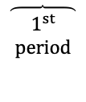
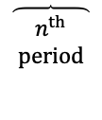
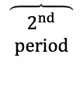
Definitions and Terminology
The annuity start date is at the beginning of the first period
The annuity end date is at the end of the last period
$$\overbrace{\begin{aligned}1^{st} \\ period \end{aligned}}$$
$$\overbrace{\begin{aligned}2^{nd} \\ period \end{aligned}}$$
$$⋯$$
$$\overbrace{\begin{aligned}n^{th} \\ period \end{aligned}}$$

Slide 10
Definitions and Terminology
The annuity start date is at the beginning of the first period
The annuity end date is at the end of the last period
$$\overbrace{\begin{aligned}1^{st} \\ period \end{aligned}}$$
$$\overbrace{\begin{aligned}2^{nd} \\ period \end{aligned}}$$
$$⋯$$
$$\overbrace{\begin{aligned}n^{th} \\ period \end{aligned}}$$
$$start$$
$$date$$
$$end$$
$$date$$

Slide 11
Definitions and Terminology
An annuity is called an annuity immediate (or ordinary annuity) if the payments are at the end of each period.
$$\overbrace{\begin{aligned}1^{st} \\ period \end{aligned}}$$
$$\overbrace{\begin{aligned}2^{nd} \\ period \end{aligned}}$$
$$⋯$$
$$\overbrace{\begin{aligned}n^{th} \\ period \end{aligned}}$$

Slide 12
Definitions and Terminology
An annuity is called an annuity immediate (or ordinary annuity) if the payments are at the end of each period.
$$X_{1}$$
$$\overbrace{\begin{aligned}1^{st} \\ period \end{aligned}}$$
$$\overbrace{\begin{aligned}2^{nd} \\ period \end{aligned}}$$
$$⋯$$
$$\overbrace{\begin{aligned}n^{th} \\ period \end{aligned}}$$

Slide 13
Definitions and Terminology
An annuity is called an annuity immediate (or ordinary annuity) if the payments are at the end of each period.
$$X_{1}$$
$$X_{2}$$
$$\overbrace{\begin{aligned}1^{st} \\ period \end{aligned}}$$
$$\overbrace{\begin{aligned}2^{nd} \\ period \end{aligned}}$$
$$⋯$$
$$\overbrace{\begin{aligned}n^{th} \\ period \end{aligned}}$$

Slide 14
Definitions and Terminology
An annuity is called an annuity immediate (or ordinary annuity) if the payments are at the end of each period.
$$X_{1}$$
$$X_{2}$$
$$⋯$$
$$X_{n}$$
$$\overbrace{\begin{aligned}1^{st} \\ period \end{aligned}}$$
$$\overbrace{\begin{aligned}2^{nd} \\ period \end{aligned}}$$
$$⋯$$
$$\overbrace{\begin{aligned}n^{th} \\ period \end{aligned}}$$

Slide 15
Definitions and Terminology
An annuity is called an annuity due if the payments are at the beginning of each period.
$$\overbrace{\begin{aligned}1^{st} \\ period \end{aligned}}$$
$$\overbrace{\begin{aligned}2^{nd} \\ period \end{aligned}}$$
$$⋯$$
$$\overbrace{\begin{aligned}n^{th} \\ period \end{aligned}}$$

Slide 16
Definitions and Terminology
An annuity is called an annuity due if the payments are at the beginning of each period.
$$X_{1}$$
$$\overbrace{\begin{aligned}1^{st} \\ period \end{aligned}}$$
$$\overbrace{\begin{aligned}2^{nd} \\ period \end{aligned}}$$
$$⋯$$
$$\overbrace{\begin{aligned}n^{th} \\ period \end{aligned}}$$

Slide 17
Definitions and Terminology
An annuity is called an annuity due if the payments are at the beginning of each period.
$$X_{1}$$
$$X_{2}$$
$$\overbrace{\begin{aligned}1^{st} \\ period \end{aligned}}$$
$$\overbrace{\begin{aligned}2^{nd} \\ period \end{aligned}}$$
$$⋯$$
$$\overbrace{\begin{aligned}n^{th} \\ period \end{aligned}}$$

Slide 18
Definitions and Terminology
An annuity is called an annuity due if the payments are at the beginning of each period.
$$X_{1}$$
$$X_{2}$$
$$⋯$$
$$X_{n}$$
$$\overbrace{\begin{aligned}1^{st} \\ period \end{aligned}}$$
$$\overbrace{\begin{aligned}2^{nd} \\ period \end{aligned}}$$
$$⋯$$
$$\overbrace{\begin{aligned}n^{th} \\ period \end{aligned}}$$

Slide 19
Definitions and Terminology
All financial calculations have a valuation date. The value of an annuity at the valuation date is the single sum value at the valuation date in which one is indifferent to receiving instead of the receiving the periodic payments that form the annuity.

Slide 20
Definitions and Terminology
$$7000$$
$$2000$$
$$5000$$

Slide 21
Definitions and Terminology
$$7000$$
$$2000$$
$$5000$$

Slide 22
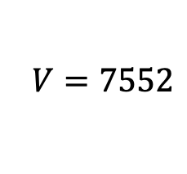
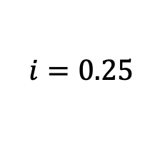
Definitions and Terminology
$$7000$$
$$2000$$
$$5000$$
$$i=0.25$$
$$V=7552$$

Slide 23
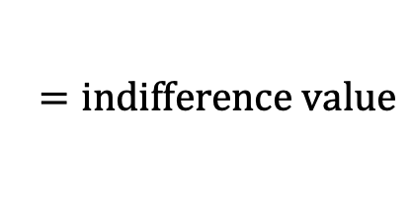
Definitions and Terminology
$$7000$$
$$2000$$
$$5000$$
$$i=0.25$$
$$V=7552$$
$$=indifference value$$

Slide 24
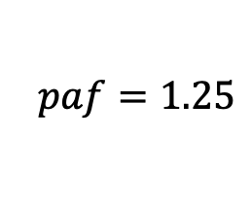
Definitions and Terminology
$$7000$$
$$2000$$
$$5000$$
$$i=0.25$$
$$paf=1.25$$
$$V=7552$$

Slide 25
Definitions and Terminology
$$7000$$
$$2000$$
$$5000$$
$$i=0.25$$
$$paf=1.25$$
$$V=7552$$
$$=A_{0}$$

Slide 26
Definitions and Terminology
$$7000$$
$$2000$$
$$5000$$
$$i=0.25$$
$$paf=1.25$$
$$V=7552$$
$$A_{2^{−}}=7552∙{\left(1.25\right)}^{2}=11800$$

Slide 27
Definitions and Terminology
$$7000$$
$$2000$$
$$5000$$
$$i=0.25$$
$$paf=1.25$$
$$V=7552$$
$$A_{2^{−}}=7552∙{\left(1.25\right)}^{2}=11800$$
$$A_{2^{+}}=11800−7000=4800$$

Slide 28
Definitions and Terminology
$$7000$$
$$2000$$
$$5000$$
$$i=0.25$$
$$paf=1.25$$
$$V=7552$$
$$A_{2^{−}}=7552∙{\left(1.25\right)}^{2}=11800$$
$$A_{2^{+}}=11800−7000=4800$$
$$A_{3^{−}}=4800∙(1.25)=6000$$

Slide 29
Definitions and Terminology
$$7000$$
$$2000$$
$$5000$$
$$i=0.25$$
$$paf=1.25$$
$$V=7552$$
$$A_{2^{−}}=7552∙{\left(1.25\right)}^{2}=11800$$
$$A_{2^{+}}=11800−7000=4800$$
$$A_{3^{−}}=4800∙(1.25)=6000$$
$$A_{3^{+}}=6000−2000=4000$$

Slide 30
Definitions and Terminology
$$7000$$
$$2000$$
$$5000$$
$$i=0.25$$
$$paf=1.25$$
$$V=7552$$
$$A_{2^{−}}=7552∙{\left(1.25\right)}^{2}=11800$$
$$A_{2^{+}}=11800−7000=4800$$
$$A_{3^{−}}=4800∙(1.25)=6000$$
$$A_{3^{+}}=6000−2000=4000$$
$$A_{4^{−}}=4000∙(1.25)=5000$$

Slide 31
Definitions and Terminology
$$7000$$
$$2000$$
$$5000$$
$$i=0.25$$
$$paf=1.25$$
$$V=7552$$
$$A_{2^{−}}=7552∙{\left(1.25\right)}^{2}=11800$$
$$A_{2^{+}}=11800−7000=4800$$
$$A_{3^{−}}=4800∙(1.25)=6000$$
$$A_{3^{+}}=6000−2000=4000$$
$$A_{4^{−}}=4000∙(1.25)=5000$$
$$A_{4^{+}}=5000−5000=0$$

Slide 32
Definitions and Terminology
A basic level annuity is a sequence of periodic payments, all of which are equal to 1
$$1$$
$$1$$
$$⋯$$
$$1$$

Slide 33
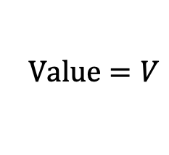
Definitions and Terminology
A basic level annuity is a sequence of periodic payments, all of which are equal to 1
$$1$$
$$1$$
$$⋯$$
$$1$$
$$Value=V$$

Slide 34
Definitions and Terminology
A basic level annuity is a sequence of periodic payments, all of which are equal to 1
$$1$$
$$1$$
$$⋯$$
$$1$$
$$Value=V$$
$$V=the value at the valuation date of a basic level annuity$$

Slide 35
Definitions and Terminology
$$2$$
$$2$$
$$⋯$$
$$2$$

Slide 36

Definitions and Terminology
$$2$$
$$2$$
$$⋯$$
$$2$$
$$Value=?$$

Slide 37
Definitions and Terminology
$$1$$
$$1$$
$$⋯$$
$$1$$
$$1$$
$$1$$
$$⋯$$
$$1$$

Slide 38
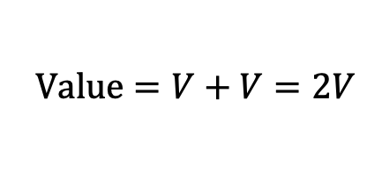
Definitions and Terminology
$$1$$
$$1$$
$$⋯$$
$$1$$
$$1$$
$$1$$
$$⋯$$
$$1$$
$$Value=V+V=2V$$

Slide 39
Definitions and Terminology
$$1$$
$$1$$
$$⋯$$
$$1$$
$$1$$
$$1$$
$$⋯$$
$$1$$
$$Value=V+V=2V$$
$$V=the value at the valuation date of a basic level annuity$$

Slide 40
Definitions and Terminology
$$X$$
$$X$$
$$⋯$$
$$X$$
$$Value=?$$

Slide 41
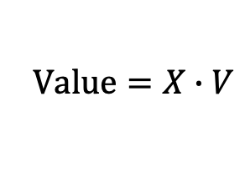
Definitions and Terminology
$$X$$
$$X$$
$$⋯$$
$$X$$
$$Value=X∙V$$
$$V=the value at the valuation date of a basic level annuity$$

Slide 42
Definitions and Terminology
A perpetuity is an annuity in which the payments continue forever.
$$X_{1}$$
$$X_{2}$$
$$X_{3}$$
$$⋯$$

Slide 43
Definitions and Terminology
A perpetuity is an annuity in which the payments continue forever.
A perpetuity has no end date.
$$X_{1}$$
$$X_{2}$$
$$X_{3}$$
$$⋯$$

Slide 44
Definitions and Terminology
A perpetuity is an annuity in which the payments continue forever.
A perpetuity has no end date.
$$X_{1}$$
$$X_{2}$$
$$X_{3}$$
$$⋯$$

Slide 45
Definitions and Terminology
A perpetuity is an annuity in which the payments continue forever.
A perpetuity has no end date.
$$X_{1}$$
$$X_{2}$$
$$X_{3}$$
$$⋯$$
$$\overbrace{\begin{aligned}1^{st} \\ period \end{aligned}}$$

Slide 46
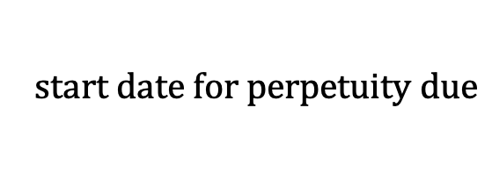
Definitions and Terminology
A perpetuity is an annuity in which the payments continue forever.
A perpetuity has no end date.
$$X_{1}$$
$$X_{2}$$
$$X_{3}$$
$$⋯$$
$$start date for perpetuity due$$

Slide 47
Definitions and Terminology
A perpetuity is an annuity in which the payments continue forever.
A perpetuity has no end date.
$$X_{1}$$
$$X_{2}$$
$$X_{3}$$
$$⋯$$

Slide 48
Definitions and Terminology
A perpetuity is an annuity in which the payments continue forever.
A perpetuity has no end date.
$$X_{1}$$
$$X_{2}$$
$$X_{3}$$
$$⋯$$

Slide 49
Definitions and Terminology
A perpetuity is an annuity in which the payments continue forever.
A perpetuity has no end date.
$$X_{1}$$
$$X_{2}$$
$$X_{3}$$
$$⋯$$
$$\overbrace{\begin{aligned}1^{st} \\ period \end{aligned}}$$

Slide 50
Definitions and Terminology
A perpetuity is an annuity in which the payments continue forever.
A perpetuity has no end date.
$$X_{1}$$
$$X_{2}$$
$$X_{3}$$
$$⋯$$
$$start date for perpetuity immediate$$

Slide 51
Definitions and Terminology
A perpetuity is an annuity in which the payments continue forever.
A perpetuity has no end date.
$$X_{1}$$
$$X_{2}$$
$$X_{3}$$
$$⋯$$
$$start date for perpetuity due$$
$$start date for perpetuity immediate$$

