Slide 1
SOA Exam FM
Module 2 – Section 3
Basic Upper m Annuities

Slide 2



$$Basic Upper m Annuity$$
Example: 3-year annuity due paying 1 per year
$$1$$
$$1$$
$$1$$
Years
0
1
2
3

Slide 3

$$Basic Upper m Annuity$$
Example: 3-year annuity due paying 1 per year
$$1$$
$$1$$
$$1$$
Years
0
1
2
3
$i=aeir$

Slide 4
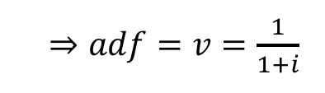
$$Basic Upper m Annuity$$
Example: 3-year annuity due paying 1 per year
$$1$$
$$1$$
$$1$$
Years
0
1
2
3
$i=aeir$
$⇒adf=v=\frac{1}{1+i}$

Slide 5
$$Basic Upper m Annuity$$
Example: 3-year annuity due paying 1 per year
$$1$$
$$1$$
$$1$$
Years
0
1
2
3
$i=aeir$
$⇒adf=v=\frac{1}{1+i}$

Slide 6

$$Basic Upper m Annuity$$
Example: 3-year annuity due paying 1 per year
$$1$$
$$1$$
$$1$$
Years
0
1
2
3
$i=aeir$
$⇒adf=v=\frac{1}{1+i}$
$$PV=1+v+v^{2} = \frac{1−v^{3}}{d}={\ddot{a}}_{\overline{3|}i}^{}$$
$$VEP$$
$$CRF$$

Slide 7

$$Basic Upper m Annuity$$
Example: 3-year annuity due paying 1 per year
$$m=1$$
$$1$$
$$1$$
$$1$$
Years
0
1
2
3
$i=aeir$
$⇒adf=v=\frac{1}{1+i}$
$$PV=1+v+v^{2} = \frac{1−v^{3}}{d}={\ddot{a}}_{\overline{3|}i}^{}$$
$$VEP$$
$$CRF$$

Slide 8

$$Basic Upper m Annuity$$
Example: 3-year annuity due paying 1 per year
$$m=2$$
$$1$$
$$1$$
$$1$$
Years
0
1
2
3
$i=aeir$
$⇒adf=v=\frac{1}{1+i}$

Slide 9
$$Basic Upper m Annuity$$
Example: 3-year annuity due paying 1 per year
$$m=2$$
$$1$$
$$1$$
$$1$$
Years
0
1
2
3
$i=aeir$
$⇒adf=v=\frac{1}{1+i}$

Slide 10


$$Basic Upper m Annuity$$
Example: 3-year annuity due paying 1 per year
$$m=2$$
$$\frac{1}{2}$$
$$\frac{1}{2}$$
Years
0
1
2
3
$i=aeir$
$⇒adf=v=\frac{1}{1+i}$

Slide 11

$$Basic Upper m Annuity$$
Example: 3-year annuity due paying 1 per year
$$m=2$$
$$\frac{1}{2}$$
$$\frac{1}{2}$$
$$\frac{1}{2}$$
$$\frac{1}{2}$$
Years
0
1
2
3
$i=aeir$
$⇒adf=v=\frac{1}{1+i}$

Slide 12
$$Basic Upper m Annuity$$
Example: 3-year annuity due paying 1 per year
$$m=2$$
$$\frac{1}{2}$$
$$\frac{1}{2}$$
$$\frac{1}{2}$$
$$\frac{1}{2}$$
$$\frac{1}{2}$$
$$\frac{1}{2}$$
Years
0
1
2
3
$i=aeir$
$⇒adf=v=\frac{1}{1+i}$

Slide 13
$$Basic Upper m Annuity$$
Example: 3-year annuity due paying 1 per year
$$m=2$$
$$\frac{1}{2}$$
$$\frac{1}{2}$$
$$\frac{1}{2}$$
$$\frac{1}{2}$$
$$\frac{1}{2}$$
$$\frac{1}{2}$$
Years
0
1
2
3
$i=aeir$
$⇒adf=v=\frac{1}{1+i}$

Slide 14

$$Basic Upper m Annuity$$
Example: 3-year annuity due paying 1 per year
$$m=2$$
$$\frac{1}{2}$$
$$\frac{1}{2}$$
$$\frac{1}{2}$$
$$\frac{1}{2}$$
$$\frac{1}{2}$$
$$\frac{1}{2}$$
Years
0
1
2
3
$i=aeir$
$⇒adf=v=\frac{1}{1+i}$
$$PV= \frac{1}{2}+\frac{1}{2}v^{\frac{1}{2}}+\frac{1}{2}v+\frac{1}{2}v^{\frac{3}{2}}+\frac{1}{2}v^{2}+\frac{1}{2}v^{\frac{5}{2}}$$
$$VEP$$

Slide 15
$$Basic Upper m Annuity$$
Example: 3-year annuity due paying 1 per year
$$m=2$$
$$\frac{1}{2}$$
$$\frac{1}{2}$$
$$\frac{1}{2}$$
$$\frac{1}{2}$$
$$\frac{1}{2}$$
$$\frac{1}{2}$$
Years
0
1
2
3
$i=aeir$
$⇒adf=v=\frac{1}{1+i}$
$$PV= \frac{1}{2}+\frac{1}{2}v^{\frac{1}{2}}+\frac{1}{2}v+\frac{1}{2}v^{\frac{3}{2}}+\frac{1}{2}v^{2}+\frac{1}{2}v^{\frac{5}{2}}$$
$$VEP$$
$$Value of Geometric Sum =\frac{first term−first omitted term}{1−ratio}$$

Slide 16
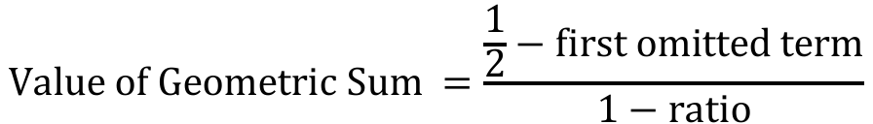
$$Basic Upper m Annuity$$
Example: 3-year annuity due paying 1 per year
$$m=2$$
$$\frac{1}{2}$$
$$\frac{1}{2}$$
$$\frac{1}{2}$$
$$\frac{1}{2}$$
$$\frac{1}{2}$$
$$\frac{1}{2}$$
Years
0
1
2
3
$i=aeir$
$⇒adf=v=\frac{1}{1+i}$
$$PV= \frac{1}{2}+\frac{1}{2}v^{\frac{1}{2}}+\frac{1}{2}v+\frac{1}{2}v^{\frac{3}{2}}+\frac{1}{2}v^{2}+\frac{1}{2}v^{\frac{5}{2}}$$
$$VEP$$
$$Value of Geometric Sum =\frac{\frac{1}{2}−first omitted term}{1−ratio}$$

Slide 17
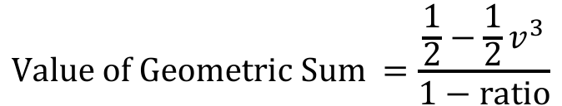
$$Basic Upper m Annuity$$
Example: 3-year annuity due paying 1 per year
$$m=2$$
$$\frac{1}{2}$$
$$\frac{1}{2}$$
$$\frac{1}{2}$$
$$\frac{1}{2}$$
$$\frac{1}{2}$$
$$\frac{1}{2}$$
Years
0
1
2
3
$i=aeir$
$⇒adf=v=\frac{1}{1+i}$
$$PV= \frac{1}{2}+\frac{1}{2}v^{\frac{1}{2}}+\frac{1}{2}v+\frac{1}{2}v^{\frac{3}{2}}+\frac{1}{2}v^{2}+\frac{1}{2}v^{\frac{5}{2}}$$
$$VEP$$
$$Value of Geometric Sum =\frac{\frac{1}{2}−\frac{1}{2}v^{3}}{1−ratio}$$

Slide 18
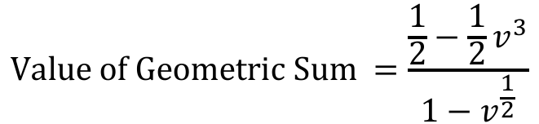
$$Basic Upper m Annuity$$
Example: 3-year annuity due paying 1 per year
$$m=2$$
$$\frac{1}{2}$$
$$\frac{1}{2}$$
$$\frac{1}{2}$$
$$\frac{1}{2}$$
$$\frac{1}{2}$$
$$\frac{1}{2}$$
Years
0
1
2
3
$i=aeir$
$⇒adf=v=\frac{1}{1+i}$
$$PV= \frac{1}{2}+\frac{1}{2}v^{\frac{1}{2}}+\frac{1}{2}v+\frac{1}{2}v^{\frac{3}{2}}+\frac{1}{2}v^{2}+\frac{1}{2}v^{\frac{5}{2}}$$
$$VEP$$
$$Value of Geometric Sum =\frac{\frac{1}{2}−\frac{1}{2}v^{3}}{1−v^{\frac{1}{2}}}$$

Slide 19
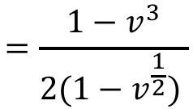
$$Basic Upper m Annuity$$
Example: 3-year annuity due paying 1 per year
$$m=2$$
$$\frac{1}{2}$$
$$\frac{1}{2}$$
$$\frac{1}{2}$$
$$\frac{1}{2}$$
$$\frac{1}{2}$$
$$\frac{1}{2}$$
Years
0
1
2
3
$i=aeir$
$⇒adf=v=\frac{1}{1+i}$
$$PV= \frac{1}{2}+\frac{1}{2}v^{\frac{1}{2}}+\frac{1}{2}v+\frac{1}{2}v^{\frac{3}{2}}+\frac{1}{2}v^{2}+\frac{1}{2}v^{\frac{5}{2}}$$
$$VEP$$
$$Value of Geometric Sum =\frac{\frac{1}{2}−\frac{1}{2}v^{3}}{1−v^{\frac{1}{2}}}$$
$$=\frac{1−v^{3}}{2(1−v^{\frac{1}{2}}) }$$

Slide 20
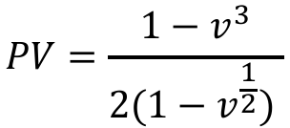
$$Basic Upper m Annuity$$
Example: 3-year annuity due paying 1 per year
$$m=2$$
$$\frac{1}{2}$$
$$\frac{1}{2}$$
$$\frac{1}{2}$$
$$\frac{1}{2}$$
$$\frac{1}{2}$$
$$\frac{1}{2}$$
Years
0
1
2
3
$i=aeir$
$⇒adf=v=\frac{1}{1+i}$
$$PV= \frac{1}{2}+\frac{1}{2}v^{\frac{1}{2}}+\frac{1}{2}v+\frac{1}{2}v^{\frac{3}{2}}+\frac{1}{2}v^{2}+\frac{1}{2}v^{\frac{5}{2}}$$
$$VEP$$
$$PV=\frac{1−v^{3}}{2(1−v^{\frac{1}{2}}) }$$

Slide 21
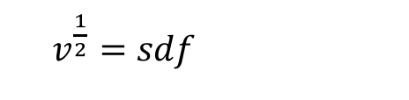
$$Basic Upper m Annuity$$
Example: 3-year annuity due paying 1 per year
$$m=2$$
$$\frac{1}{2}$$
$$\frac{1}{2}$$
$$\frac{1}{2}$$
$$\frac{1}{2}$$
$$\frac{1}{2}$$
$$\frac{1}{2}$$
Years
0
1
2
3
$i=aeir$
$⇒adf=v=\frac{1}{1+i}$
$$PV= \frac{1}{2}+\frac{1}{2}v^{\frac{1}{2}}+\frac{1}{2}v+\frac{1}{2}v^{\frac{3}{2}}+\frac{1}{2}v^{2}+\frac{1}{2}v^{\frac{5}{2}}$$
$$VEP$$
$$PV=\frac{1−v^{3}}{2(1−v^{\frac{1}{2}}) }$$
$v^{\frac{1}{2}}=sdf$

Slide 22
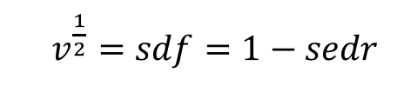
$$Basic Upper m Annuity$$
Example: 3-year annuity due paying 1 per year
$$m=2$$
$$\frac{1}{2}$$
$$\frac{1}{2}$$
$$\frac{1}{2}$$
$$\frac{1}{2}$$
$$\frac{1}{2}$$
$$\frac{1}{2}$$
Years
0
1
2
3
$i=aeir$
$⇒adf=v=\frac{1}{1+i}$
$$PV= \frac{1}{2}+\frac{1}{2}v^{\frac{1}{2}}+\frac{1}{2}v+\frac{1}{2}v^{\frac{3}{2}}+\frac{1}{2}v^{2}+\frac{1}{2}v^{\frac{5}{2}}$$
$$VEP$$
$$PV=\frac{1−v^{3}}{2(1−v^{\frac{1}{2}}) }$$
$v^{\frac{1}{2}}=sdf=1−sedr$

Slide 23

$$Basic Upper m Annuity$$
Example: 3-year annuity due paying 1 per year
$$m=2$$
$$\frac{1}{2}$$
$$\frac{1}{2}$$
$$\frac{1}{2}$$
$$\frac{1}{2}$$
$$\frac{1}{2}$$
$$\frac{1}{2}$$
Years
0
1
2
3
$i=aeir$
$⇒adf=v=\frac{1}{1+i}$
$$PV= \frac{1}{2}+\frac{1}{2}v^{\frac{1}{2}}+\frac{1}{2}v+\frac{1}{2}v^{\frac{3}{2}}+\frac{1}{2}v^{2}+\frac{1}{2}v^{\frac{5}{2}}$$
$$VEP$$
$$PV=\frac{1−v^{3}}{2(1−v^{\frac{1}{2}}) }$$
$v^{\frac{1}{2}}=sdf=1−sedr$
$$=1−\frac{d^{(2)}}{2}$$

Slide 24
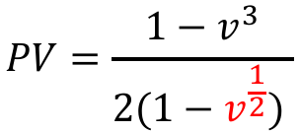

$$Basic Upper m Annuity$$
Example: 3-year annuity due paying 1 per year
$$m=2$$
$$\frac{1}{2}$$
$$\frac{1}{2}$$
$$\frac{1}{2}$$
$$\frac{1}{2}$$
$$\frac{1}{2}$$
$$\frac{1}{2}$$
Years
0
1
2
3
$i=aeir$
$⇒adf=v=\frac{1}{1+i}$
$$PV= \frac{1}{2}+\frac{1}{2}v^{\frac{1}{2}}+\frac{1}{2}v+\frac{1}{2}v^{\frac{3}{2}}+\frac{1}{2}v^{2}+\frac{1}{2}v^{\frac{5}{2}}$$
$$VEP$$
$$PV=\frac{1−v^{3}}{2(1−v^{\frac{1}{2}}) }$$
$v^{\frac{1}{2}}=sdf=1−sedr$
$$=1−\frac{d^{(2)}}{2}$$

Slide 25

$$Basic Upper m Annuity$$
Example: 3-year annuity due paying 1 per year
$$m=2$$
$$\frac{1}{2}$$
$$\frac{1}{2}$$
$$\frac{1}{2}$$
$$\frac{1}{2}$$
$$\frac{1}{2}$$
$$\frac{1}{2}$$
Years
0
1
2
3
$i=aeir$
$⇒adf=v=\frac{1}{1+i}$
$$PV= \frac{1}{2}+\frac{1}{2}v^{\frac{1}{2}}+\frac{1}{2}v+\frac{1}{2}v^{\frac{3}{2}}+\frac{1}{2}v^{2}+\frac{1}{2}v^{\frac{5}{2}}$$
$$= \frac{1−v^{3}}{d^{\left(2\right)}}$$
$$VEP$$

Slide 26
$$Basic Upper m Annuity$$
Example: 3-year annuity due paying 1 per year
$$m=2$$
$$\frac{1}{2}$$
$$\frac{1}{2}$$
$$\frac{1}{2}$$
$$\frac{1}{2}$$
$$\frac{1}{2}$$
$$\frac{1}{2}$$
Years
0
1
2
3
$i=aeir$
$⇒adf=v=\frac{1}{1+i}$
$$PV= \frac{1}{2}+\frac{1}{2}v^{\frac{1}{2}}+\frac{1}{2}v+\frac{1}{2}v^{\frac{3}{2}}+\frac{1}{2}v^{2}+\frac{1}{2}v^{\frac{5}{2}}$$
$$= \frac{1−v^{3}}{d^{\left(2\right)}}$$
$$VEP$$
$$CRF$$

Slide 27

$$Basic Upper m Annuity$$
Example: 3-year annuity due paying 1 per year
$$m=2$$
$$\frac{1}{2}$$
$$\frac{1}{2}$$
$$\frac{1}{2}$$
$$\frac{1}{2}$$
$$\frac{1}{2}$$
$$\frac{1}{2}$$
Years
0
1
2
3
$i=aeir$
$⇒adf=v=\frac{1}{1+i}$
$$PV= \frac{1}{2}+\frac{1}{2}v^{\frac{1}{2}}+\frac{1}{2}v+\frac{1}{2}v^{\frac{3}{2}}+\frac{1}{2}v^{2}+\frac{1}{2}v^{\frac{5}{2}}$$
$$= \frac{1−v^{3}}{d^{\left(2\right)}}$$
$$VEP$$
$$CRF$$
$$={\ddot{a}}_{\overline{3|}i}^{\left(2\right)}$$

Slide 28
$$Basic Upper m Annuity$$
Example: 3-year annuity due paying 1 per year
$$m=2$$
$$\frac{1}{2}$$
$$\frac{1}{2}$$
$$\frac{1}{2}$$
$$\frac{1}{2}$$
$$\frac{1}{2}$$
$$\frac{1}{2}$$
Years
0
1
2
3
$i=aeir$
$⇒adf=v=\frac{1}{1+i}$
$$PV= \frac{1}{2}+\frac{1}{2}v^{\frac{1}{2}}+\frac{1}{2}v+\frac{1}{2}v^{\frac{3}{2}}+\frac{1}{2}v^{2}+\frac{1}{2}v^{\frac{5}{2}}$$
$$= \frac{1−v^{3}}{d^{\left(2\right)}}$$
$$VEP$$
$$CRF$$
$$={\ddot{a}}_{\overline{3|}i}^{\left(2\right)}$$
Read: a double-dot angle 3 upper 2

Slide 29

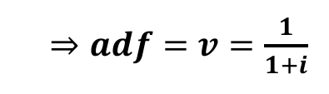
$$Basic Upper m Annuity$$
Example: 3-year annuity due paying 1 per year
$$m=2$$
$$\frac{1}{2}$$
$$\frac{1}{2}$$
$$\frac{1}{2}$$
$$\frac{1}{2}$$
$$\frac{1}{2}$$
$$\frac{1}{2}$$
Years
0
1
2
3
$i=aeir$
$⇒adf=v=\frac{1}{1+i}$
$$PV= \frac{1}{2}+\frac{1}{2}v^{\frac{1}{2}}+\frac{1}{2}v+\frac{1}{2}v^{\frac{3}{2}}+\frac{1}{2}v^{2}+\frac{1}{2}v^{\frac{5}{2}}$$
$$= \frac{1−v^{3}}{d^{\left(2\right)}}$$
$$VEP$$
$$CRF$$
$$={\ddot{a}}_{\overline{3|}i}^{\left(2\right)}$$

Slide 30
$$Basic Upper m Annuity$$
Example: 3-year annuity immediate paying 1 per year
$$1$$
$$1$$
$$1$$
Years
0
1
2
3
$i=aeir$
$⇒adf=v=\frac{1}{1+i}$

Slide 31

$$Basic Upper m Annuity$$
Example: 3-year annuity immediate paying 1 per year
$$m=1$$
$$1$$
$$1$$
$$1$$
Years
0
1
2
3
$i=aeir$
$⇒adf=v=\frac{1}{1+i}$
$$PV=v+v^{2}+v^{3}= \frac{1−v^{3}}{i}=a_{\overline{3|}i}^{}$$
$$VEP$$
$$CRF$$

Slide 32

$$Basic Upper m Annuity$$
Example: 3-year annuity immediate paying 1 per year
$$m=4$$
$$1$$
$$1$$
$$1$$
Years
0
1
2
3
$i=aeir$
$⇒adf=v=\frac{1}{1+i}$

Slide 33
$$Basic Upper m Annuity$$
Example: 3-year annuity immediate paying 1 per year
$$m=4$$
$$1$$
$$1$$
$$1$$
Years
0
1
2
3
$i=aeir$
$⇒adf=v=\frac{1}{1+i}$

Slide 34

$$Basic Upper m Annuity$$
Example: 3-year annuity immediate paying 1 per year
$$m=4$$
$$\frac{1}{4}$$
$$\frac{1}{4}$$
$$\frac{1}{4}$$
$$\frac{1}{4}$$
Years
0
1
2
3
$i=aeir$
$⇒adf=v=\frac{1}{1+i}$

Slide 35
$$Basic Upper m Annuity$$
Example: 3-year annuity immediate paying 1 per year
$$m=4$$
$$\frac{1}{4}$$
$$\frac{1}{4}$$
$$\frac{1}{4}$$
$$\frac{1}{4}$$
$$\frac{1}{4}$$
$$\frac{1}{4}$$
$$\frac{1}{4}$$
$$\frac{1}{4}$$
Years
0
1
2
3
$i=aeir$
$⇒adf=v=\frac{1}{1+i}$

Slide 36
$$Basic Upper m Annuity$$
Example: 3-year annuity immediate paying 1 per year
$$m=4$$
$$\frac{1}{4}$$
$$\frac{1}{4}$$
$$\frac{1}{4}$$
$$\frac{1}{4}$$
$$\frac{1}{4}$$
$$\frac{1}{4}$$
$$\frac{1}{4}$$
$$\frac{1}{4}$$
$$\frac{1}{4}$$
$$\frac{1}{4}$$
$$\frac{1}{4}$$
$$\frac{1}{4}$$
Years
0
1
2
3
$i=aeir$
$⇒adf=v=\frac{1}{1+i}$

Slide 37

$$Basic Upper m Annuity$$
Example: 3-year annuity immediate paying 1 per year
$$m=4$$
$$\frac{1}{4}$$
$$\frac{1}{4}$$
$$\frac{1}{4}$$
$$\frac{1}{4}$$
$$\frac{1}{4}$$
$$\frac{1}{4}$$
$$\frac{1}{4}$$
$$\frac{1}{4}$$
$$\frac{1}{4}$$
$$\frac{1}{4}$$
$$\frac{1}{4}$$
$$\frac{1}{4}$$
Years
0
1
2
3
$i=aeir$
$⇒adf=v=\frac{1}{1+i}$
$$PV= \frac{1}{4}v^{\frac{1}{4}}+\frac{1}{4}v^{\frac{1}{2}}+\frac{1}{4}v^{\frac{3}{4}}+⋯+\frac{1}{4}v^{3}$$
$$VEP$$

Slide 38

$$Basic Upper m Annuity$$
Example: 3-year annuity immediate paying 1 per year
$$m=4$$
$$\frac{1}{4}$$
$$\frac{1}{4}$$
$$\frac{1}{4}$$
$$\frac{1}{4}$$
$$\frac{1}{4}$$
$$\frac{1}{4}$$
$$\frac{1}{4}$$
$$\frac{1}{4}$$
$$\frac{1}{4}$$
$$\frac{1}{4}$$
$$\frac{1}{4}$$
$$\frac{1}{4}$$
Years
0
1
2
3
$i=aeir$
$⇒adf=v=\frac{1}{1+i}$
$$PV= \frac{1}{4}v^{\frac{1}{4}}+\frac{1}{4}v^{\frac{1}{2}}+\frac{1}{4}v^{\frac{3}{4}}+⋯+\frac{1}{4}v^{3}$$
$$=$$
$$VEP$$
$$CRF$$

Slide 39

$$Basic Upper m Annuity$$
Example: 3-year annuity immediate paying 1 per year
$$m=4$$
$$\frac{1}{4}$$
$$\frac{1}{4}$$
$$\frac{1}{4}$$
$$\frac{1}{4}$$
$$\frac{1}{4}$$
$$\frac{1}{4}$$
$$\frac{1}{4}$$
$$\frac{1}{4}$$
$$\frac{1}{4}$$
$$\frac{1}{4}$$
$$\frac{1}{4}$$
$$\frac{1}{4}$$
Years
0
1
2
3
$i=aeir$
$⇒adf=v=\frac{1}{1+i}$
$$PV= \frac{1}{4}v^{\frac{1}{4}}+\frac{1}{4}v^{\frac{1}{2}}+\frac{1}{4}v^{\frac{3}{4}}+⋯+\frac{1}{4}v^{3}$$
$${=a}_{\overline{3|}i}^{\left(4\right)}$$
$$=$$
$$VEP$$
$$CRF$$

Slide 40
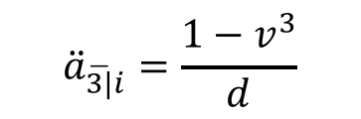
$$Basic Upper m Annuity$$
Example: 3-year annuity immediate paying 1 per year
$$m=4$$
$$\frac{1}{4}$$
$$\frac{1}{4}$$
$$\frac{1}{4}$$
$$\frac{1}{4}$$
$$\frac{1}{4}$$
$$\frac{1}{4}$$
$$\frac{1}{4}$$
$$\frac{1}{4}$$
$$\frac{1}{4}$$
$$\frac{1}{4}$$
$$\frac{1}{4}$$
$$\frac{1}{4}$$
Years
0
1
2
3
$i=aeir$
$⇒adf=v=\frac{1}{1+i}$
$$PV= \frac{1}{4}v^{\frac{1}{4}}+\frac{1}{4}v^{\frac{1}{2}}+\frac{1}{4}v^{\frac{3}{4}}+⋯+\frac{1}{4}v^{3}$$
$${=a}_{\overline{3|}i}^{\left(4\right)}$$
$$=$$
$$VEP$$
$$CRF$$
$${\ddot{a}}_{\overline{3|}i}^{}=\frac{1−v^{3}}{d}$$

Slide 41
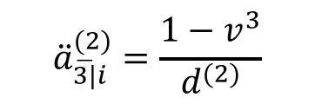
$$Basic Upper m Annuity$$
Example: 3-year annuity immediate paying 1 per year
$$m=4$$
$$\frac{1}{4}$$
$$\frac{1}{4}$$
$$\frac{1}{4}$$
$$\frac{1}{4}$$
$$\frac{1}{4}$$
$$\frac{1}{4}$$
$$\frac{1}{4}$$
$$\frac{1}{4}$$
$$\frac{1}{4}$$
$$\frac{1}{4}$$
$$\frac{1}{4}$$
$$\frac{1}{4}$$
Years
0
1
2
3
$i=aeir$
$⇒adf=v=\frac{1}{1+i}$
$$PV= \frac{1}{4}v^{\frac{1}{4}}+\frac{1}{4}v^{\frac{1}{2}}+\frac{1}{4}v^{\frac{3}{4}}+⋯+\frac{1}{4}v^{3}$$
$${=a}_{\overline{3|}i}^{\left(4\right)}$$
$$=$$
$$VEP$$
$$CRF$$
$${\ddot{a}}_{\overline{3|}i}^{}=\frac{1−v^{3}}{d}$$
$${\ddot{a}}_{\overline{3|}i}^{(2)}=\frac{1−v^{3}}{d^{(2)}}$$

Slide 42
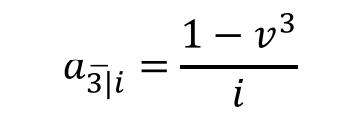
$$Basic Upper m Annuity$$
Example: 3-year annuity immediate paying 1 per year
$$m=4$$
$$\frac{1}{4}$$
$$\frac{1}{4}$$
$$\frac{1}{4}$$
$$\frac{1}{4}$$
$$\frac{1}{4}$$
$$\frac{1}{4}$$
$$\frac{1}{4}$$
$$\frac{1}{4}$$
$$\frac{1}{4}$$
$$\frac{1}{4}$$
$$\frac{1}{4}$$
$$\frac{1}{4}$$
Years
0
1
2
3
$i=aeir$
$⇒adf=v=\frac{1}{1+i}$
$$PV= \frac{1}{4}v^{\frac{1}{4}}+\frac{1}{4}v^{\frac{1}{2}}+\frac{1}{4}v^{\frac{3}{4}}+⋯+\frac{1}{4}v^{3}$$
$${=a}_{\overline{3|}i}^{\left(4\right)}$$
$$=$$
$$VEP$$
$$CRF$$
$${\ddot{a}}_{\overline{3|}i}^{}=\frac{1−v^{3}}{d}$$
$${\ddot{a}}_{\overline{3|}i}^{(2)}=\frac{1−v^{3}}{d^{(2)}}$$
$$a_{\overline{3|}i}^{}=\frac{1−v^{3}}{i}$$

Slide 43

$$Basic Upper m Annuity$$
Example: 3-year annuity immediate paying 1 per year
$$m=4$$
$$\frac{1}{4}$$
$$\frac{1}{4}$$
$$\frac{1}{4}$$
$$\frac{1}{4}$$
$$\frac{1}{4}$$
$$\frac{1}{4}$$
$$\frac{1}{4}$$
$$\frac{1}{4}$$
$$\frac{1}{4}$$
$$\frac{1}{4}$$
$$\frac{1}{4}$$
$$\frac{1}{4}$$
Years
0
1
2
3
$i=aeir$
$⇒adf=v=\frac{1}{1+i}$
$$PV= \frac{1}{4}v^{\frac{1}{4}}+\frac{1}{4}v^{\frac{1}{2}}+\frac{1}{4}v^{\frac{3}{4}}+⋯+\frac{1}{4}v^{3}$$
$${=a}_{\overline{3|}i}^{\left(4\right)}$$
$$=$$
$$VEP$$
$$CRF$$
$${\ddot{a}}_{\overline{3|}i}^{}=\frac{1−v^{3}}{d}$$
$${\ddot{a}}_{\overline{3|}i}^{(2)}=\frac{1−v^{3}}{d^{(2)}}$$
$$a_{\overline{3|}i}^{}=\frac{1−v^{3}}{i}$$

Slide 44

$$Basic Upper m Annuity$$
Example: 3-year annuity immediate paying 1 per year
$$m=4$$
$$\frac{1}{4}$$
$$\frac{1}{4}$$
$$\frac{1}{4}$$
$$\frac{1}{4}$$
$$\frac{1}{4}$$
$$\frac{1}{4}$$
$$\frac{1}{4}$$
$$\frac{1}{4}$$
$$\frac{1}{4}$$
$$\frac{1}{4}$$
$$\frac{1}{4}$$
$$\frac{1}{4}$$
Years
0
1
2
3
$i=aeir$
$⇒adf=v=\frac{1}{1+i}$
$$PV= \frac{1}{4}v^{\frac{1}{4}}+\frac{1}{4}v^{\frac{1}{2}}+\frac{1}{4}v^{\frac{3}{4}}+⋯+\frac{1}{4}v^{3}$$
$$\frac{1−v^{3}}{i^{\left(4\right)}}$$
$$=$$
$${=a}_{\overline{3|}i}^{\left(4\right)}$$
$$VEP$$
$$CRF$$

Slide 45
$$Basic Upper m Annuity$$
Example: 3-year annuity immediate paying 1 per year
$$m=4$$
$$\frac{1}{4}$$
$$\frac{1}{4}$$
$$\frac{1}{4}$$
$$\frac{1}{4}$$
$$\frac{1}{4}$$
$$\frac{1}{4}$$
$$\frac{1}{4}$$
$$\frac{1}{4}$$
$$\frac{1}{4}$$
$$\frac{1}{4}$$
$$\frac{1}{4}$$
$$\frac{1}{4}$$
Years
0
1
2
3
$i=aeir$
$⇒adf=v=\frac{1}{1+i}$
$$PV= \frac{1}{4}v^{\frac{1}{4}}+\frac{1}{4}v^{\frac{1}{2}}+\frac{1}{4}v^{\frac{3}{4}}+⋯+\frac{1}{4}v^{3}$$
$$\frac{1−v^{3}}{i^{\left(4\right)}}$$
$$=$$
$${=a}_{\overline{3|}i}^{\left(4\right)}$$
$$VEP$$
$$CRF$$
Note: The valuation date is one payment period before first payment!

Slide 46


$$Basic Upper m Annuity$$
Example: Represent symbolically, using upper $m$ notation, and give the closed rule formula for the value of a 10-year annuity that pays 500 every month using a valuation date that is immediately after the final payment.

Slide 47
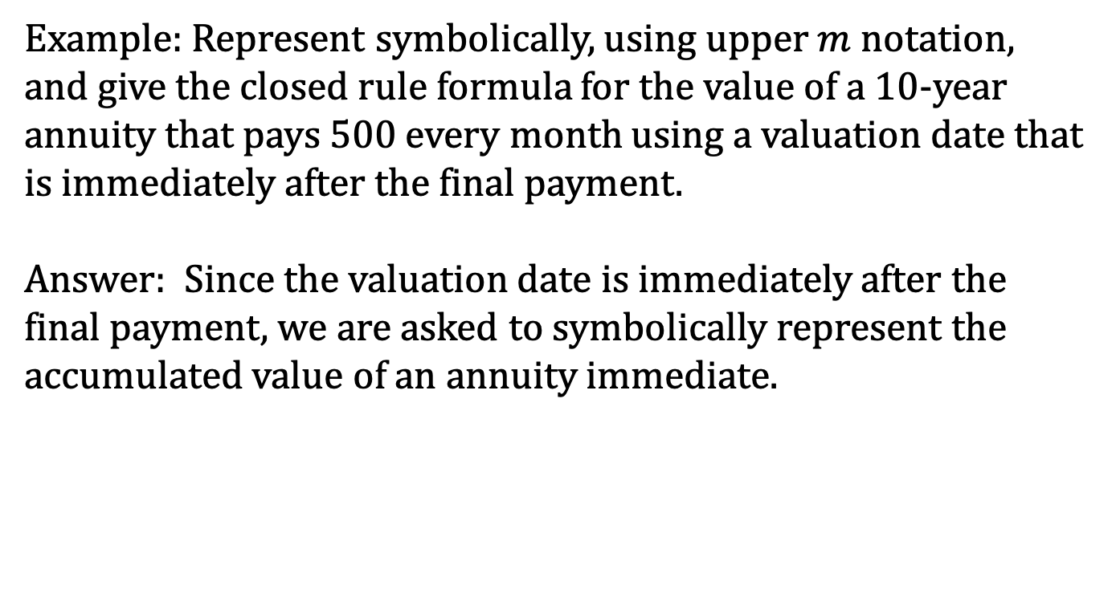
$$Basic Upper m Annuity$$
Example: Represent symbolically, using upper $m$ notation, and give the closed rule formula for the value of a 10-year annuity that pays 500 every month using a valuation date that is immediately after the final payment.
Answer: Since the valuation date is immediately after the final payment, we are asked to symbolically represent the accumulated value of an annuity immediate.

Slide 48
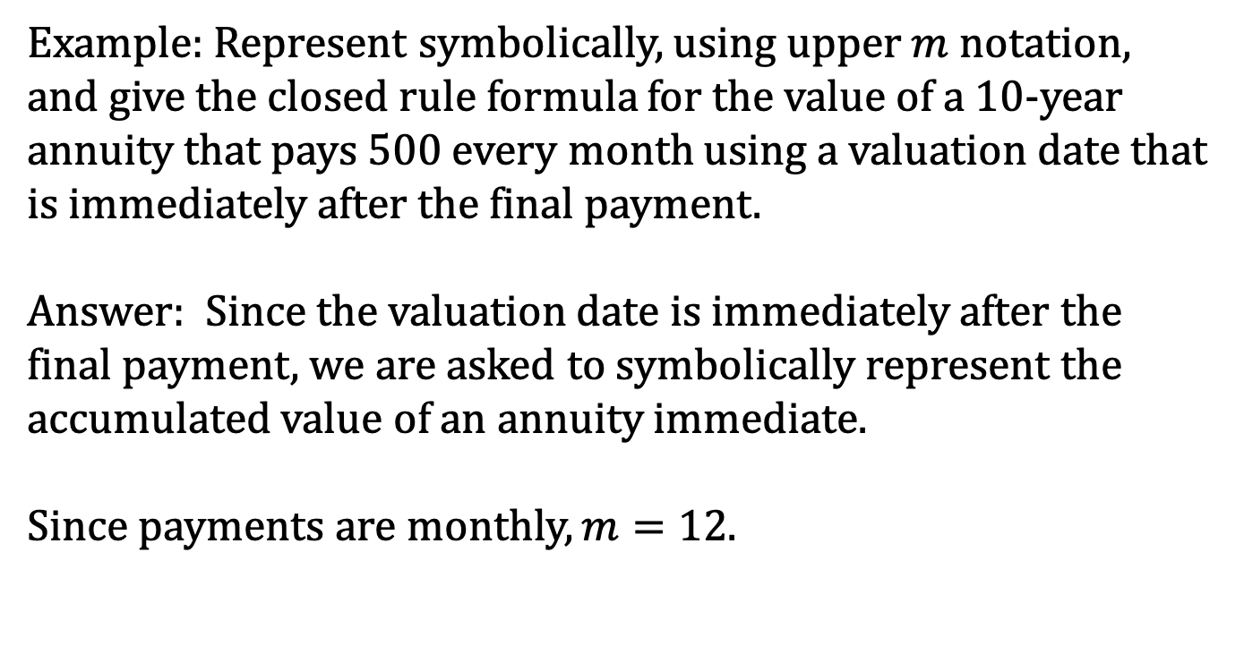
$$Basic Upper m Annuity$$
Example: Represent symbolically, using upper $m$ notation, and give the closed rule formula for the value of a 10-year annuity that pays 500 every month using a valuation date that is immediately after the final payment.
Answer: Since the valuation date is immediately after the final payment, we are asked to symbolically represent the accumulated value of an annuity immediate.
Since payments are monthly, $m=12$.

Slide 49

$$Basic Upper m Annuity$$
Example: Represent symbolically, using upper $m$ notation, and give the closed rule formula for the value of a 10-year annuity that pays 500 every month using a valuation date that is immediately after the final payment.
$$∴AV=R∙s_{\overline{10|}i}^{(12)}$$

Slide 50
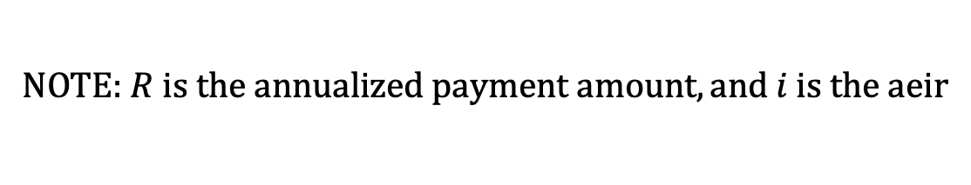
$$Basic Upper m Annuity$$
Example: Represent symbolically, using upper $m$ notation, and give the closed rule formula for the value of a 10-year annuity that pays 500 every month using a valuation date that is immediately after the final payment.
$$∴AV=R∙s_{\overline{10|}i}^{(12)}$$
NOTE: $R is the annualized payment amount, and i is the aeir$

Slide 51

$$Basic Upper m Annuity$$
Example: Represent symbolically, using upper $m$ notation, and give the closed rule formula for the value of a 10-year annuity that pays 500 every month using a valuation date that is immediately after the final payment.
$$AV=6000∙s_{\overline{10|}i}^{(12)}$$

Slide 52

$$Basic Upper m Annuity$$
Example: Represent symbolically, using upper $m$ notation, and give the closed rule formula for the value of a 10-year annuity that pays 500 every month using a valuation date that is immediately after the final payment.
$$AV=6000∙s_{\overline{10|}i}^{(12)}$$
$$s_{\overline{10|}i}^{}=\frac{{(1+i)}^{10}−1}{i}$$

Slide 53

$$Basic Upper m Annuity$$
Example: Represent symbolically, using upper $m$ notation, and give the closed rule formula for the value of a 10-year annuity that pays 500 every month using a valuation date that is immediately after the final payment.
$$AV=6000∙s_{\overline{10|}i}^{(12)}$$
$$s_{\overline{10|}i}^{(12)}=\frac{{(1+i)}^{10}−1}{i^{(12)}}$$

Slide 54

$$Basic Upper m Annuity$$
Example: Represent symbolically, using upper $m$ notation, and give the closed rule formula for the value of a 10-year annuity that pays 500 every month using a valuation date that is immediately after the final payment.
$$AV=6000∙s_{\overline{10|}i}^{(12)}$$
$$AV=6000∙\frac{{(1+i)}^{10}−1}{i^{(12)}}$$

