Slide 1
SOA Exam FM
Module 2 – Section 7
Rainbow Annuities

Slide 2


$$Rainbow Annuities$$
A basic rainbow annuity is an annuity in which the payments are:
$$1, 2, ⋯, \left(n−1\right), n, \left(n−1\right), ⋯, 2, 1$$

Slide 3









$$Rainbow Annuities$$
A basic rainbow annuity is an annuity in which the payments are:
$$1$$
$$2$$
$$⋯$$
$$n−1$$
$$n$$
$$n−1$$
$$⋯$$
$$2$$
$$1$$
$$⋯$$
$$⋯$$

Slide 4
$$Rainbow Annuities$$
$$1$$
$$2$$
$$⋯$$
$$n−1$$
$$n$$
$$n−1$$
$$⋯$$
$$2$$
$$1$$
$$⋯$$
$$⋯$$

Slide 5


$$Rainbow Annuities$$
$$1$$
$$2$$
$$⋯$$
$$n−1$$
$$n$$
$$n−1$$
$$⋯$$
$$2$$
$$1$$
$$⋯$$
$$⋯$$
$$PV$$
$$={\left({\ddot{a}}_{\overline{n|}}\right)}^{2}$$

Slide 6
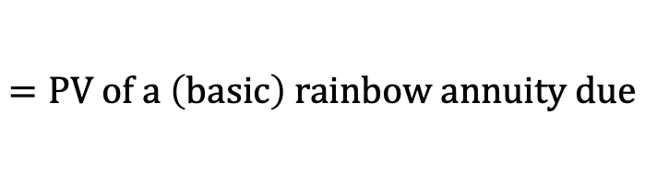
$$Rainbow Annuities$$
$$1$$
$$2$$
$$⋯$$
$$n−1$$
$$n$$
$$n−1$$
$$⋯$$
$$2$$
$$1$$
$$⋯$$
$$⋯$$
$$PV$$
$$={\left({\ddot{a}}_{\overline{n|}}\right)}^{2}$$
$$=PV of a \left(basic\right) rainbow annuity due$$

Slide 7





$$Rainbow Annuities$$
$$1$$
$$2$$
$$⋯$$
$$n−1$$
$$n$$
$$n−1$$
$$⋯$$
$$2$$
$$1$$
$$⋯$$
$$⋯$$
$$PV$$
$$={\left({\ddot{a}}_{\overline{n|}}\right)}^{2}$$
$$=PV of a \left(basic\right) rainbow annuity due$$
$$PV$$
$$=(I{\ddot{a})}_{\overline{n|}}+(D{\ddot{a})}_{\overline{n−1|}}∙v^{n}$$

Slide 8


$$Rainbow Annuities$$
$$1$$
$$2$$
$$⋯$$
$$n−1$$
$$n$$
$$n−1$$
$$⋯$$
$$2$$
$$1$$
$$⋯$$
$$⋯$$
$$PV$$
$$={\left({\ddot{a}}_{\overline{n|}}\right)}^{2}$$
$$=PV of a \left(basic\right) rainbow annuity due$$
$$PV$$
$$=(I{\ddot{a})}_{\overline{n−1|}}+(D{\ddot{a})}_{\overline{n|}}∙v^{n−1}$$

Slide 9
$$Rainbow Annuities$$
$$1$$
$$2$$
$$⋯$$
$$n−1$$
$$n$$
$$n−1$$
$$⋯$$
$$2$$
$$1$$
$$⋯$$
$$⋯$$
$$PV$$
$$={\left({\ddot{a}}_{\overline{n|}}\right)}^{2}$$
$$=PV of a \left(basic\right) rainbow annuity due$$

Slide 10


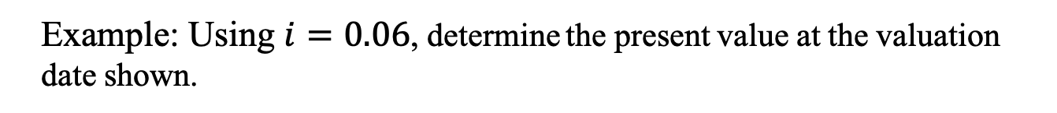



$$Rainbow Annuities$$
Example: Using $i=0.06$, determine the present value at the valuation date shown.
$$3$$
$$6$$
$$⋯$$
$$78$$
$$81$$
$$78$$
$$⋯$$
$$6$$
$$3$$
$$⋯$$
$$⋯$$

Slide 11
$$Rainbow Annuities$$
Example: Using $i=0.06$, determine the present value at the valuation date shown.
$$3$$
$$6$$
$$⋯$$
$$78$$
$$81$$
$$78$$
$$⋯$$
$$6$$
$$3$$
$$⋯$$
$$⋯$$

Slide 12

$$Rainbow Annuities$$
Example: Using $i=0.06$, determine the present value at the valuation date shown.
$$3$$
$$6$$
$$⋯$$
$$78$$
$$81$$
$$78$$
$$⋯$$
$$6$$
$$3$$
$$⋯$$
$$⋯$$
$${PV}_{0}$$

Slide 13

$$Rainbow Annuities$$
Example: Using $i=0.06$, determine the present value at the valuation date shown.
$$3$$
$$6$$
$$⋯$$
$$78$$
$$81$$
$$78$$
$$⋯$$
$$6$$
$$3$$
$$⋯$$
$$⋯$$
$${PV}_{0}$$
$${PV}_{1}$$

Slide 14
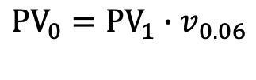
$$Rainbow Annuities$$
Example: Using $i=0.06$, determine the present value at the valuation date shown.
$$3$$
$$6$$
$$⋯$$
$$78$$
$$81$$
$$78$$
$$⋯$$
$$6$$
$$3$$
$$⋯$$
$$⋯$$
$${PV}_{0}={PV}_{1}∙v_{0.06}$$
$${PV}_{0}$$
$${PV}_{1}$$

Slide 15
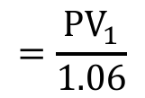
$$Rainbow Annuities$$
Example: Using $i=0.06$, determine the present value at the valuation date shown.
$$3$$
$$6$$
$$⋯$$
$$78$$
$$81$$
$$78$$
$$⋯$$
$$6$$
$$3$$
$$⋯$$
$$⋯$$
$$=\frac{{PV}_{1}}{1.06}$$
$${PV}_{0}={PV}_{1}∙v_{0.06}$$
$${PV}_{0}$$
$${PV}_{1}$$

Slide 16
$$Rainbow Annuities$$
Example: Using $i=0.06$, determine the present value at the valuation date shown.
$$3$$
$$6$$
$$⋯$$
$$78$$
$$81$$
$$78$$
$$⋯$$
$$6$$
$$3$$
$$⋯$$
$$⋯$$
$${PV}_{1}$$

Slide 17

$$Rainbow Annuities$$
Example: Using $i=0.06$, determine the present value at the valuation date shown.
$$3$$
$$6$$
$$⋯$$
$$78$$
$$81$$
$$78$$
$$⋯$$
$$6$$
$$3$$
$$⋯$$
$$⋯$$
$${PV}_{1}$$
$$=3∙{\left({\ddot{a}}_{\overline{n|}}\right)}^{2}$$

Slide 18

$$Rainbow Annuities$$
Example: Using $i=0.06$, determine the present value at the valuation date shown.
$$3$$
$$6$$
$$⋯$$
$$78$$
$$81$$
$$78$$
$$⋯$$
$$6$$
$$3$$
$$⋯$$
$$⋯$$
$$81=3∙27$$
$${PV}_{1}$$
$$=3∙{\left({\ddot{a}}_{\overline{n|}}\right)}^{2}$$

Slide 19

$$Rainbow Annuities$$
Example: Using $i=0.06$, determine the present value at the valuation date shown.
$$3$$
$$6$$
$$⋯$$
$$78$$
$$81$$
$$78$$
$$⋯$$
$$6$$
$$3$$
$$⋯$$
$$⋯$$
$${PV}_{1}$$
$$=3∙{\left({\ddot{a}}_{\overline{27|}}\right)}^{2}$$

Slide 20

$$Rainbow Annuities$$
Example: Using $i=0.06$, determine the present value at the valuation date shown.
$$3$$
$$6$$
$$⋯$$
$$78$$
$$81$$
$$78$$
$$⋯$$
$$6$$
$$3$$
$$⋯$$
$$⋯$$
$${PV}_{0}$$
$${PV}_{1}$$
$$=3∙{\left({\ddot{a}}_{\overline{27|}}\right)}^{2}$$

Slide 21
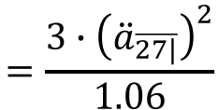

$$Rainbow Annuities$$
Example: Using $i=0.06$, determine the present value at the valuation date shown.
$$3$$
$$6$$
$$⋯$$
$$78$$
$$81$$
$$78$$
$$⋯$$
$$6$$
$$3$$
$$⋯$$
$$⋯$$
$${PV}_{0}$$
$${PV}_{1}$$
$$=3∙{\left({\ddot{a}}_{\overline{27|}}\right)}^{2}$$
$$=\frac{3∙{\left({\ddot{a}}_{\overline{27|}}\right)}^{2}}{1.06}$$
$$∴{PV}_{0}$$

Slide 22

$$Rainbow Annuities$$
Example: Using $i=0.06$, determine the present value at the valuation date shown.
$$3$$
$$6$$
$$⋯$$
$$78$$
$$81$$
$$78$$
$$⋯$$
$$6$$
$$3$$
$$⋯$$
$$⋯$$
$${PV}_{0}$$
$${PV}_{1}$$
$$=3∙{\left({\ddot{a}}_{\overline{27|}}\right)}^{2}$$
$$=\frac{3∙{\left({\ddot{a}}_{\overline{27|}}\right)}^{2}}{1.06}$$
$$∴{PV}_{0}$$
$$=554.97$$

