Slide 1
Acoustic Measurement Setup
Bhupatindra Malla, Ephraim Gutmark
University of Cincinnati

Slide 2
Far-field Acoustic Measurements
Azimuthal Angles
ɸ = 0°
ɸ = 90°
Downstream Angle
ψ = 150°
Farfield Mic Array
Position
ɸ = 180°
Ramp
Flow
Direction
Mic Num. | ψ (deg.)
1 | 35
2 | 40
3 | 50
4 | 60
5 | 70
6 | 80
7 | 90
8 | 100
9 | 110
10 | 120
11 | 130
12 | 140
13 | 150
Ramp(absent in baseline case)
Expanding side
Nozzle Exit
11.25ft
ψ = 90°
Nozzle Centerline
Data File:
.mat format.
Contains variable “p” with pressure measurements.
Each column of data corresponds to one microphone.
ɸ = 90°
ɸ = 0°
Reflected
Side
ɸ = 180°
Shielded
Side
ψ = 35°
Upstream Angle
Acquisition Frequency = 204.8kHz

Slide 3
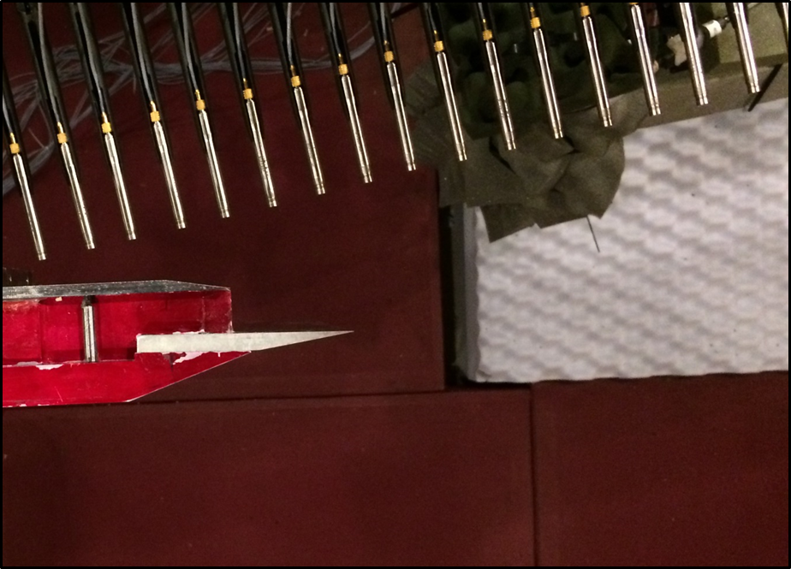
Near-field Microphone Arrangement
Traverse
Direction
1”
30”
20”
15°
1.5”
Near-field Microphone Grid
FLOW
Nozzle Exit
Ramp(absent in
baseline case)
15°
1.5”
Y
X
Mic Array on along ɸ = 0°,
Minor axis plane
Mics: ¼” B&K 4954 Free-field Condenser Mics
Acquisition Frequency = 204.8kHz
Linear array of 31 mics with 1” spacing between the mics
Array is at 15 degrees angle to the non-expanding side of the nozzle.
Array traverses perpendicular to the microphone array at steps of 1” for 20”.

